Slide 1
How do we produce highly visible (cited) academic research?
Useful tips for Junior and Senior Scholars
Dr. Mustapha Belkhouja
Grenoble Ecole de Management
France
Dr. David Yoon
University of Leeds
United Kingdom
Notes:
David

Slide 2


About the speakers
Associate Professor at Grenoble Ecole de Management (France)
Ph.D. in Economics
Research interests: Academic visibility, Reputation, Knowledge diffusion and International business
Webpage: https://en.grenoble-em.com/annuaire/mustapha-belkhouja
Assistant Professor at Leeds University Business School, University of Leeds (UK)
Ph.D. in Management
Research interests: Social evaluations in knowledge-intensive industries, Liability of foreignness in international business, Technological learning in megaprojects.
Webpage: https://business.leeds.ac.uk/about-us/our-people/staff-directory/profile/hyungseok-david-yoon/
Notes:
Mus and David

Slide 3
Personal Motivation
Collaboration
Internal vs. External
Multidisciplinarity
Specialization
vs.
Diversification
Notes:
David

Slide 4
Institutional Pressure
Producing high-impact research is a growing expectation of academics.
Not only publishing in top journal matters, but also the number of (forward) citations!
  Publish or Perish -> Visible or Vanished
While not all highly cited research papers produced by academics equate to their impact in a societal sense, it is not difficult to argue that they have been very important for academic progress.
Notes:
David

Slide 5
Speakers’ Key Publications
Main source of our Webinar presentation
‘Belkhouja, M., & Yoon, H. D. (2018). How does openness influence the impact of a scholar’s research? An analysis of business scholars’ citations over their careers. Research Policy, 47(10), 2037- 2047.’(https://doi.org/10.1016/j.respol.2018.07.012).
Other relevant publications of the presenters
(2018). A Bibliometric Analysis of the Knowledge Exchange Patterns Between Major Technology and Innovation Management Journals (1999–2013). Journal of Product Innovation Management, 35(1), 2-8.
(2018). A Twenty‐Year Citation Analysis of the Knowledge Outflow and Inflow Patterns from the Journal of Product Innovation Management. Journal of Product Innovation Management, 35(6), 854-863.
(2015). A Note On The Evolution Of The French Management Scholarship, 1994-2014. M@n@gement, 18(3), 194-204.
Notes:
David

Slide 6
Learning Outcomes
By the end of the Webinar you should be able to answer the following questions:
L1: How does your research background (e.g. unidisciplinary vs. multidisciplinary) affect the individual’s citations?
L2: How does your collaboration (e.g. internal vs. external) affect the individual’s citations?
L3: Are there differences between how early career researchers and established researchers should conduct research to attract more citations?
Notes:
David

Slide 7
Key Terms
Visibility: Number of citations
Cognitive openness: Multi-disciplinary background of individuals
Structural openness: Proportion of external collaborations of individuals
Career age: Junior vs. Senior
Notes:
David

Slide 8
Conceptual Model
Cognitive openness:
The number of different disciplines a scholar has covered up to the current year
L1
Scholar’s career stage:
The length of a scholar’s research career up to the current year
Impact of
scholars’ research:
Yearly citations
L3
Structural openness:
The ratio between the number of external collaborations and the number of collaborations of a scholar up to the current year
L2
Notes:
David

Slide 9
Data and Analytical Approach
Scopus & Web of Science (1994-2013)
159,169 articles
320 journals in business and Management
20 disciplines (ABS journal guide classification)
35,296 authors
281,930 author-year observations
Generalizability of our analysis: Multi-disciplinary research and external collaboration are becoming more important for many subjects (e.g. Life Science, Physical Science, Earth and Space, etc.) that require a large scale of resources (e.g. equipment, finance, human capital) to generate ground breaking research.
Notes:
Mus

Slide 10
Results: Learning Outcome 1
Yearly citations
Constant
Publications
FT45 publications
Prior citations
High-status institution
Unique co-authors
Repeated co-authorship
Mobility
Co-authors’ citations
High-status co-authors
Cognitive openness
Structural openness
Career age
Cognitive openness squared
Structural openness squared
Cognitive openness × Career age
Structural openness × Career age
Cognitive openness squared × Career age
Structural openness squared × Career age
Year dummies
Number of observations
Number of authors
Log likelihood
Chi-square
Model 1
-1.58***
(0.07)
0.21***
(0.00)
0.11***
(0.00)
0.56***
(0.00)
0.04***
(0.00)
0.13***
(0.00)
0.24***
(0.01)
0.04***
(0.00)
0.07***
(0.00)
0.02***
(0.00)
Yes
281,930
35,296
-668,015.82
506,408.18
Model 2
-1.53***
(0.07)
0.20***
(0.00)
0.11***
(0.00)
0.48***
(0.00)
0.04***
(0.00)
0.12***
(0.00)
0.26***
(0.01)
0.02***
(0.00)
0.08***
(0.00)
0.03***
(0.00)
0.11***
(0.01)
0.14***
(0.03)
0.17***
(0.01)
-0.01***
(0.00)
-0.18***
(0.02)
Yes
281,930
35,296
-667,741.27
502,544.14
Notes:
Mus

Slide 11
Multidisciplinary Background and Visibility
Notes:
Mus

Slide 12
Key Takeaways
Benefits of multidisciplinary background
Exposure to heterogeneous knowledge domains improves the novelty and quality of individual research output, as cognitive diversity stimulates new elaborations and trials (Rodan and Galunic, 2004): Audiences expect new ideas or insights that are produced by researchers with a multidisciplinary background (Schilling and Green, 2011; Uzzi et al., 2013)
Pitfalls of multidisciplinary background
Over-reliance on heterogeneous knowledge base makes recombination task difficult (Lee et al., 2015): Covering multiple knowledge domains limits mastery and dilutes identity, resulting in a ‘jack-of-all-trades’ who is a master of none of them (Leahey et al., 2017)
Notes:
Mus

Slide 13
Results: Learning Outcome 2
Yearly citations
Constant
Publications
FT45 publications
Prior citations
High-status institution
Unique co-authors
Repeated co-authorship
Mobility
Co-authors’ citations
High-status co-authors
Cognitive openness
Structural openness
Career age
Cognitive openness squared
Structural openness squared
Cognitive openness × Career age
Structural openness × Career age
Cognitive openness squared × Career age
Structural openness squared × Career age
Year dummies
Number of observations
Number of authors
Log likelihood
Chi-square
Model 1
-1.58***
(0.07)
0.21***
(0.00)
0.11***
(0.00)
0.56***
(0.00)
0.04***
(0.00)
0.13***
(0.00)
0.24***
(0.01)
0.04***
(0.00)
0.07***
(0.00)
0.02***
(0.00)
Yes
281,930
35,296
-668,015.82
506,408.18
Model 2
-1.53***
(0.07)
0.20***
(0.00)
0.11***
(0.00)
0.48***
(0.00)
0.04***
(0.00)
0.12***
(0.00)
0.26***
(0.01)
0.02***
(0.00)
0.08***
(0.00)
0.03***
(0.00)
0.11***
(0.01)
0.14***
(0.03)
0.17***
(0.01)
-0.01***
(0.00)
-0.18***
(0.02)
Yes
281,930
35,296
-667,741.27
502,544.14
Notes:
Mus

Slide 14
Collaboration and Visibility
Notes:
Mus

Slide 15
Key Takeaways
Benefits of external collaboration
Researchers can enhance their research impact by gaining access to external parties in order to obtain complementary resources (Nahapiet and Ghoshal, 1998): Access to databases, expertise, prestige, funds, equipment, and language skills that those scholars might lack (Eisend and Schmidt, 2014; Katz and Martin, 1997)
Pitfalls of external collaboration
Development of novel research projects entails experiencing high levels of ambiguity and uncertainty, which necessitates ongoing coordination of task activities (Hoegl and Proserpio, 2004): Difficult to allocate the proper level of attention and time to implement and produce high-impact research (Koput, 1997)
Notes:
Mus

Slide 16
Results: Learning Outcome 3
Yearly citations
Constant
Publications
FT45 publications
Prior citations
High-status institution
Unique co-authors
Repeated co-authorship
Mobility
Co-authors’ citations
High-status co-authors
Cognitive openness
Structural openness
Career age
Cognitive openness squared
Structural openness squared
Cognitive openness × Career age
Structural openness × Career age
Cognitive openness squared × Career age
Structural openness squared × Career age
Year dummies
Number of observations
Number of authors
Log likelihood
Chi-square
Model 3
-2.04***
(0.07)
0.19***
(0.00)
0.11***
(0.00)
0.51***
(0.00)
0.04***
(0.00)
0.11***
(0.00)
0.22***
(0.01)
0.02***
(0.00)
0.08***
(0.00)
0.03***
(0.00)
0.51***
(0.02)
0.77***
(0.07)
0.39***
(0.01)
-0.07***
(0.00)
-0.68***
(0.05)
-0.20***
(0.01)
-0.37***
(0.03)
0.03***
(0.00)
0.29***
(0.03)
Yes
281,930
35,296
-662,066.02
485,561.03
Notes:
Mus

Slide 17
Multidisciplinary Background and Visibility contingent upon Career Age
Notes:
Mus

Slide 18
Key Takeaways
Moderate level of multi-disciplinary research for junior scholars
Exposure to a variety of cognitive or knowledge domains develops research competence and enhances absorptive capacity for junior scholars to generate high-impact research.
As newcomers to academia, junior scholars need to build their academic identity (i.e. focusing on their core research domain) to be recognized by their peers.
High level of multi-disciplinary research for senior scholars
Late-career researchers are likely to be exposed to different knowledge domains than junior scholars (Mannucci and Yong, 2018).
Senior scholars have ability and legitimacy to recombine knowledge from different domains that will be well-received by audiences.
Notes:
Mus

Slide 19
Results: Learning Outcome 3
Yearly citations
Constant
Publications
FT45 publications
Prior citations
High-status institution
Unique co-authors
Repeated co-authorship
Mobility
Co-authors’ citations
High-status co-authors
Cognitive openness
Structural openness
Career age
Cognitive openness squared
Structural openness squared
Cognitive openness × Career age
Structural openness × Career age
Cognitive openness squared × Career age
Structural openness squared × Career age
Year dummies
Number of observations
Number of authors
Log likelihood
Chi-square
Model 3
-2.04***
(0.07)
0.19***
(0.00)
0.11***
(0.00)
0.51***
(0.00)
0.04***
(0.00)
0.11***
(0.00)
0.22***
(0.01)
0.02***
(0.00)
0.08***
(0.00)
0.03***
(0.00)
0.51***
(0.02)
0.77***
(0.07)
0.39***
(0.01)
-0.07***
(0.00)
-0.68***
(0.05)
-0.20***
(0.01)
-0.37***
(0.03)
0.03***
(0.00)
0.29***
(0.03)
Yes
281,930
35,296
-662,066.02
485,561.03
Notes:
Mus

Slide 20
Collaboration and Visibility contingent upon Career Age
Notes:
Mus

Slide 21
Key Takeaways
Moderate level of external collaboration for junior scholars
Helps to maintain internal ties and build external ties: In addition to internal resources, we can use complementary resources from outside organizational boundaries (i.e. external collaboration) to enhance visibility (e.g. visiting researcher)
Internal collaboration for senior scholars
Spill-over of senior scholars’ research leadership: Mentorship role to help other researchers (e.g. junior) at the same institution by promoting their research
Notes:
Mus

Slide 22
Wrap-up (1/2)
To enhance your visibility, it is important to consider the basis of the authors’ knowledge, as well as their co-authors’ physical locations.
Strategies should also be devised to foster the visibility of an individual’s research based on the stage of their career.
  There should be moderate levels of multidisciplinarity and internal / external activity for those who are early in their career, and for established academics our results suggest a high level of multidisciplinary working and local collaboration is the key to enhancing their academic impact.
For more information, please read the authors' publication ‘Belkhouja, M., & Yoon, H. D. (2018). How does openness influence the impact of a scholar’s research? An analysis of business scholars’ citations over their careers. Research Policy, 47(10), 2037-2047.’
(https://doi.org/10.1016/j.respol.2018.07.012)
Notes:
David

Slide 23
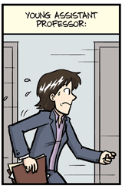
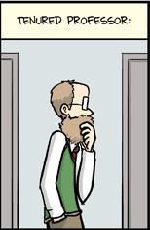
Wrap-up (2/2)
Collaboration
Internal vs. External
Multidisciplinarity
Specialization
vs.
Diversification
Notes:
David

Slide 24
Follow-up Project
How diversity (knowledge, geographic, and cultural) influences research teams to publish in top journals and attract citations?
Follow us on
Mustapha’s Mendeley:
https://www.mendeley.com/profiles/mustapha-belkhouja2/
David’s Mendeley:
https://www.mendeley.com/authors/57198835793/
David’s Twitter:
https://twitter.com/davidhsyoon
Notes:
David

Slide 25
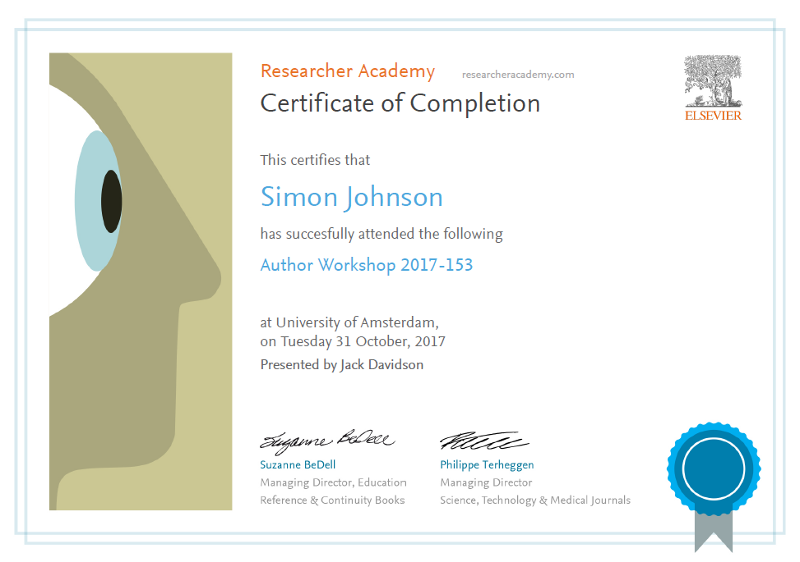
Thank you.
Ask your questions on:
Researcher Academy Mendeley group
Follow us on Twitter

