Slide 1
How to make the most of
your PhD capabilities
and find fulfilling jobs
Career development for early career researchers
Chiat Cheong and Ralph Rousseau
24 January 2019

Slide 2
Introducing the presenters
Chiat Cheong PhD
• Founder Qia Consultancy & Training
Career orientation for scientists, coaching
• Policy advisor at the University of Amsterdam
Ralph Rousseau PhD
• Assistant professor at Utrecht University
• Professional musician
• Motivational speaker

Slide 3
Outline
How do you take decisions regarding your professional future?
Options: no options, too many options?
An important first step in career orientation
PhD graduates identifying unexpected opportunities
A strategy for career orientation

Slide 4
How do you take decisions regarding your professional future?
Targeting Early Career Researchers (ECRs)
but applicable to any stage
Started career in academia
After your PhD or postdoc:
  Continue in academia do you want this?
              positions available?
  Continue outside academia do you want this?
  do you feel competent?
  suitable positions?

Slide 5
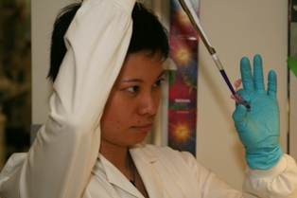
About Chiat
MSc in Biomedical Sciences: research = great!
⇣
PhD in Biomedical Sciences in 2005
Cancer gene therapy using viral vectors
⇣
Postdoc (4 years contract)
Cancer Virotherapy
⇣

Slide 6
About Chiat
MSc in Biomedical Sciences: research = great!
⇣
PhD in Biomedical Sciences in 2005
Cancer gene therapy using viral vectors
⇣
Postdoc (4 years contract)
Cancer Virotherapy
⇣
Future (from 2009):
another postdoc
⇣
assistant professor/get tenured?
⇣
full professor?

Slide 7
About Chiat
MSc in Biomedical Sciences: research = great!
⇣
PhD in Biomedical Sciences in 2005
Cancer gene therapy using viral vectors
⇣
Postdoc (4 years contract)
Cancer Virotherapy
⇣
Future?! (from 2009):
2008 another postdoc
⇣
assistant professor/get tenured?
⇣
full professor?
Future work
more people-focussed
more communication
more direct impact
…

Slide 8
What options?
Future work
more people-focussed
more communication
more direct impact
…
My profile
molecular biologist specialised
in researching new treatments of advanced prostate cancer with viruses
???

Slide 9
How do you take decisions regarding your professional future?
Targeting Early Career Researchers (ECRs)
but applicable to any stage
Started career in academia
After your PhD or postdoc:
  not every ECR wants to continue in academia
  not every ECR will be able to continue in academia
If not academia, then what else?
No options?

Slide 10
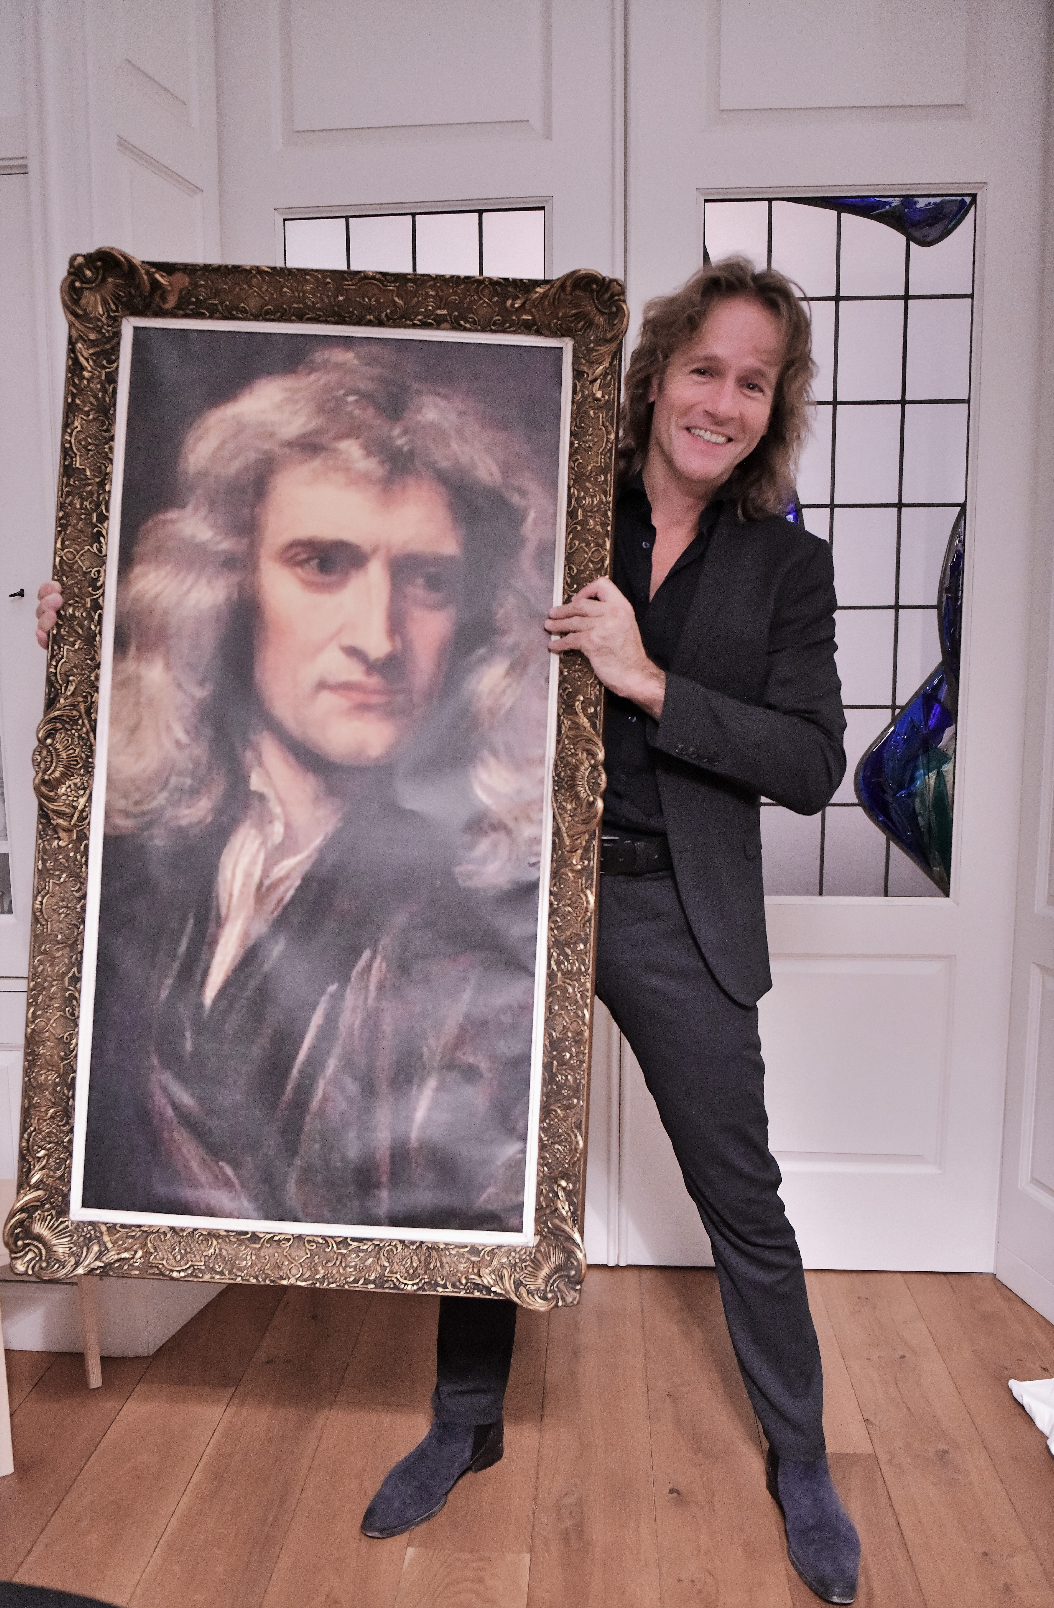

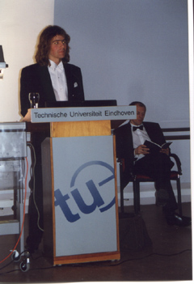
Ralph Rousseau
(Meulenbroeks)

Slide 11

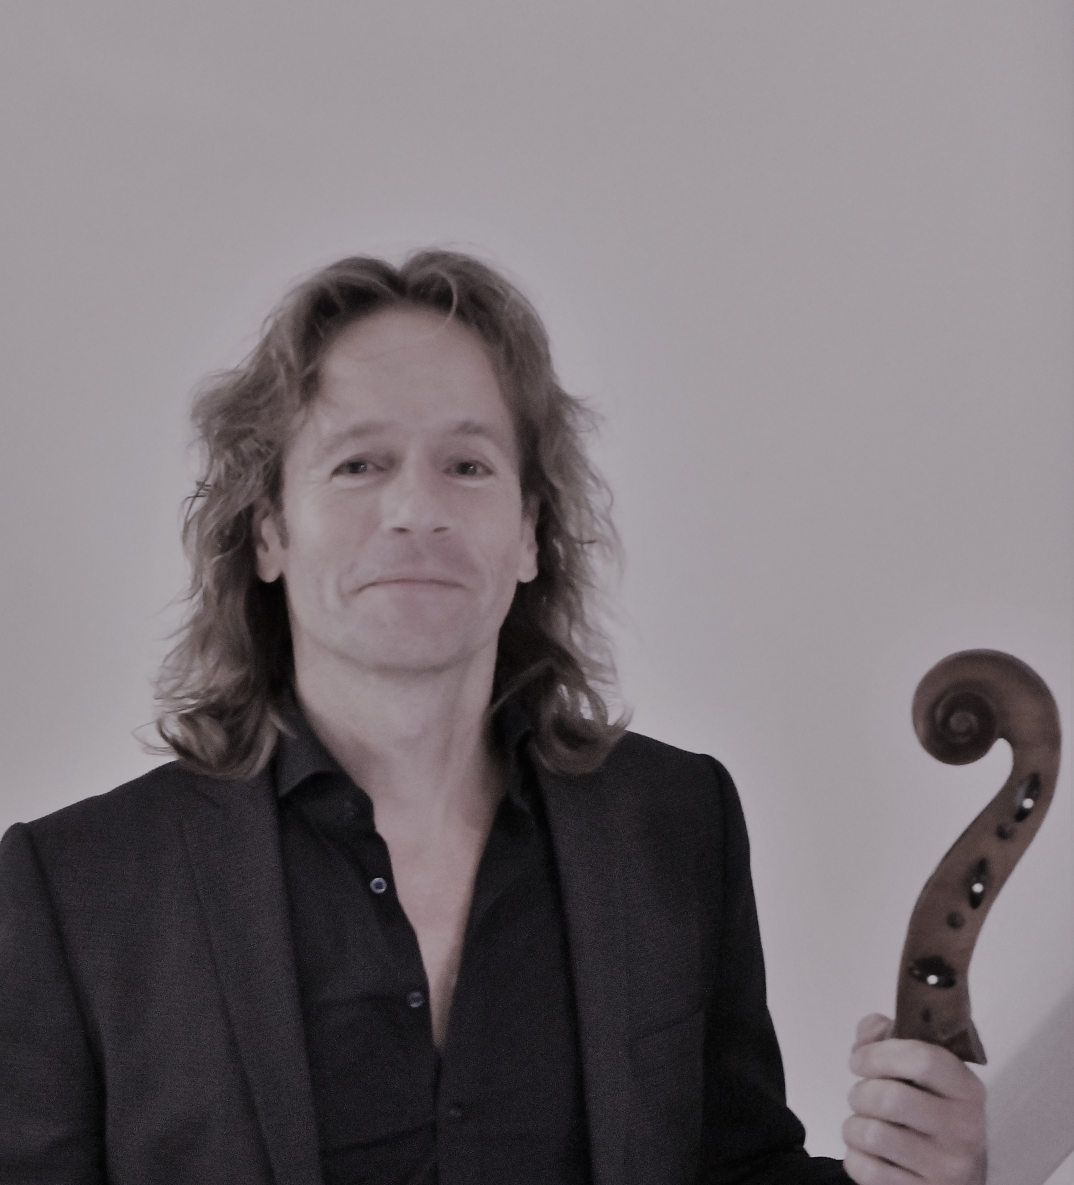
Ralph Rousseau

Slide 12
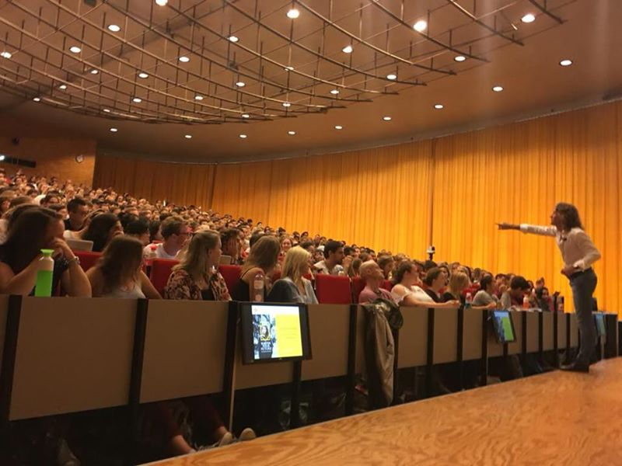
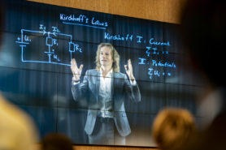
Ralph Rousseau
(Meulenbroeks)

Slide 13
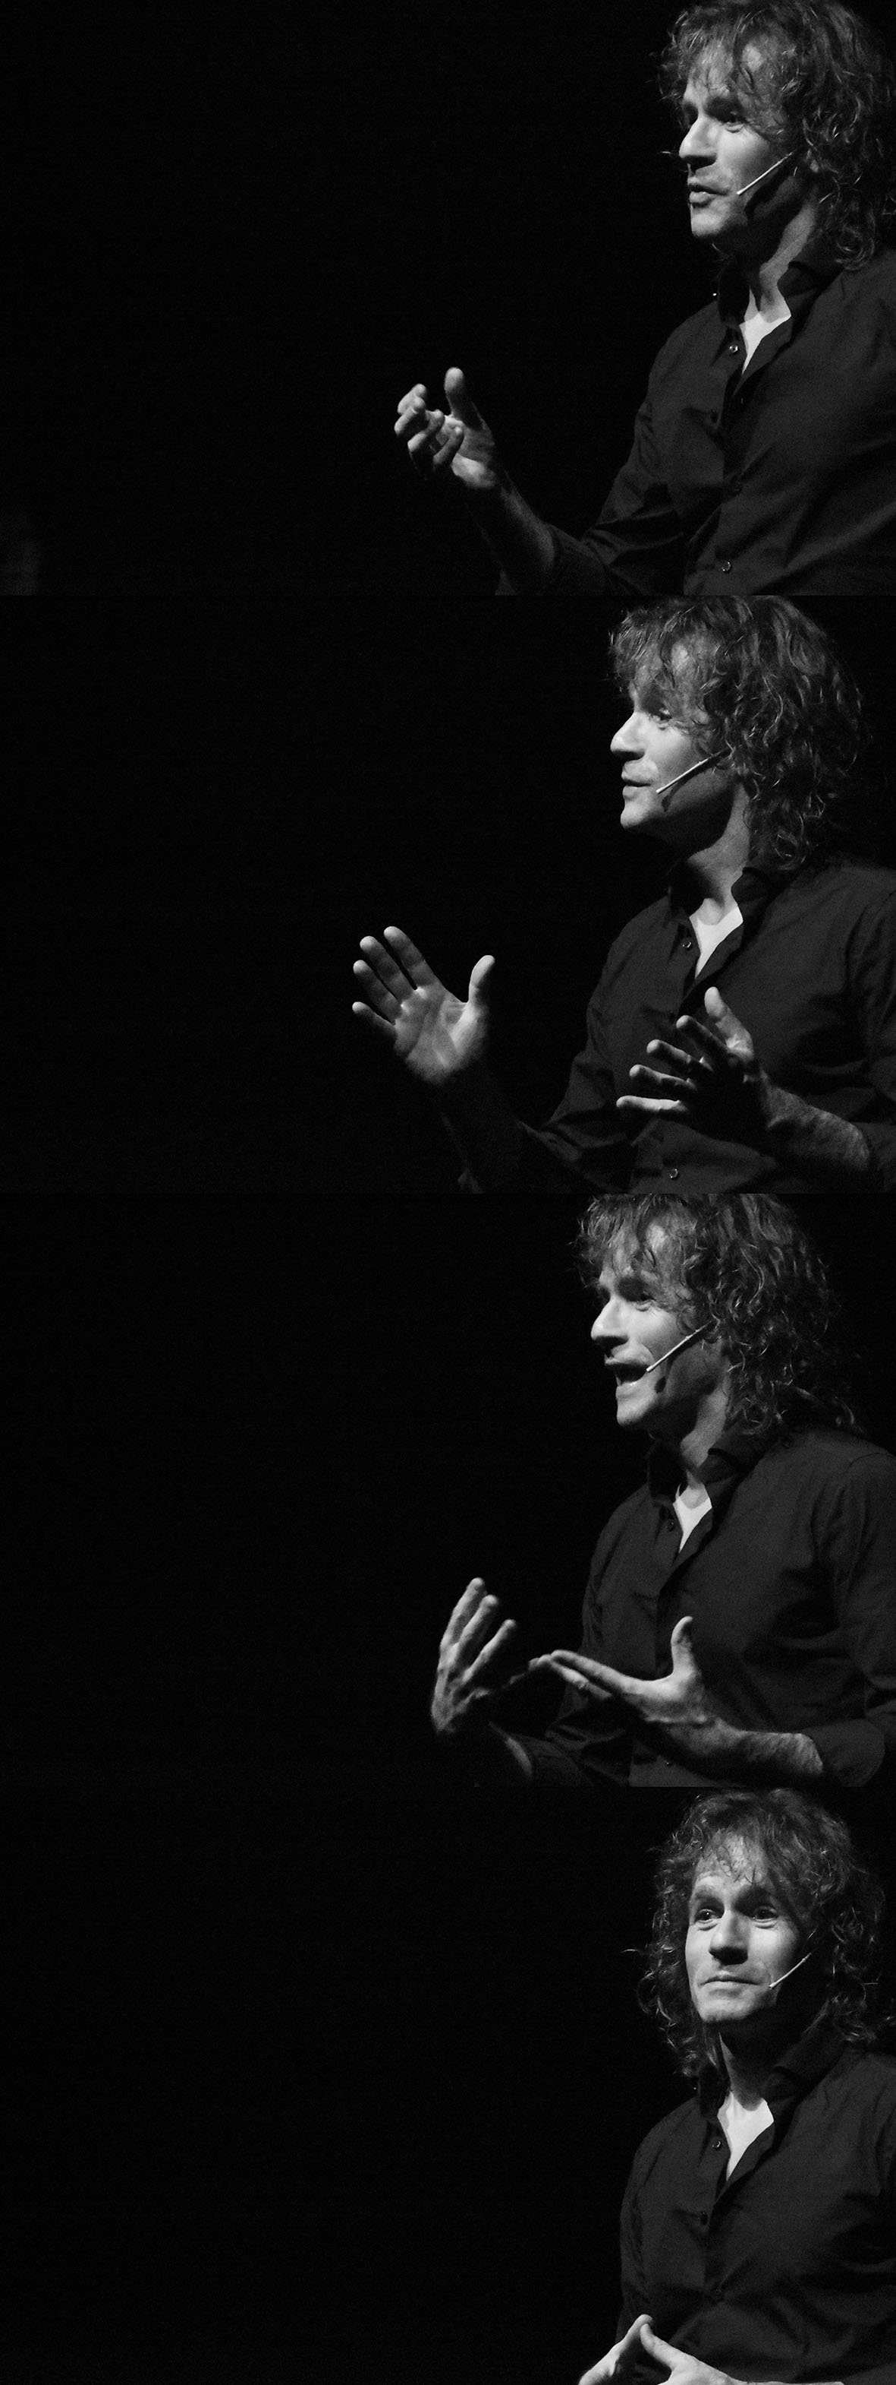
Ralph Rousseau
(Meulenbroeks)

Slide 14
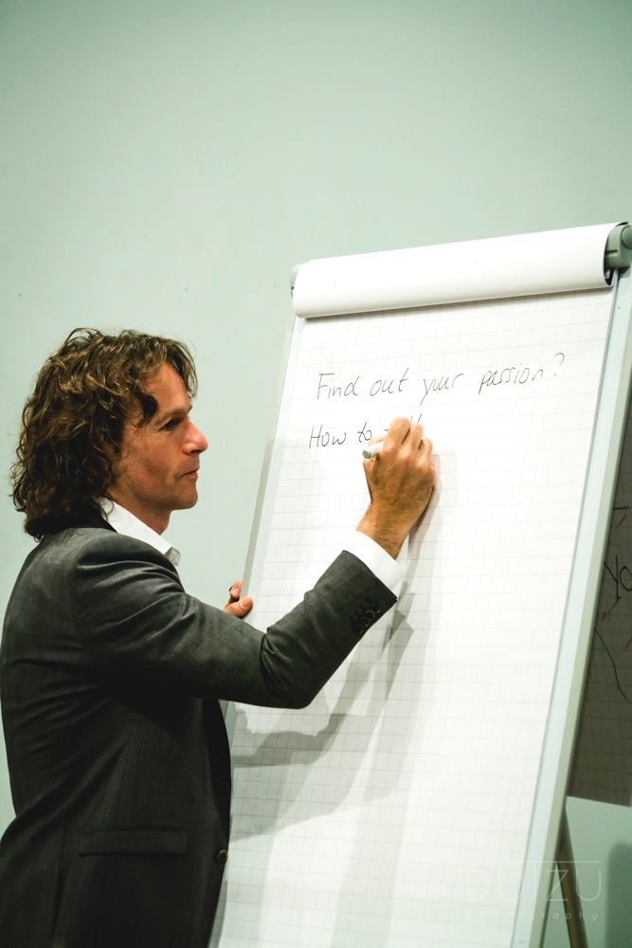

Ralph Rousseau

Slide 15
How do you take decisions regarding your professional future?
Targeting Early Career Researchers (ECRs)
but applicable to any stage
Started career in academia
After your PhD or postdoc:
  not every ECR wants to continue in academia
  not every ECR will be able to continue in academia
If not academia, then what else?
No options? Many options!
Notes:
Chiat

Slide 17
Options for PhD graduates
technical advisor
consultant
project coordinator
policy advisor
data scientist
research manager
institute manager
product specialist
scientific writer
Notes:
Chiat

Slide 18
Options for PhD graduates
scientific study manager
technical advisor
consultant
teacher
project coordinator
policy advisor
business developer
data scientist
journal publisher
research manager
institute manager
product specialist
scientific writer
entrepreneur

Slide 19
Options for PhD graduates
scientific study manager
performing artist
technical advisor
consultant
teacher
project coordinator
policy advisor
business developer
data scientist
journal publisher
research manager
software engineer
institute manager
patent attorney
trainer/coach
product specialist
scientific writer
grant coordinator
entrepreneur

Slide 20
Options for PhD graduates
scientific study manager
performing artist
project leader
technical advisor
innovation manager
consultant
teacher
project coordinator
programme manager
policy advisor
business developer
data scientist
journal publisher
research manager
software engineer
institute manager
patent attorney
journalist
trainer/coach
product specialist
scientific writer
grant coordinator
entrepreneur

Slide 21
Options for PhD graduates
scientific study manager
performing artist
project leader
technical advisor
innovation manager
consultant
teacher
project coordinator
programme manager
policy advisor
business developer
wine specialist
data scientist
journal publisher
research manager
software engineer
institute manager
patent attorney
journalist
trainer/coach
product specialist
scientific writer
grant coordinator
entrepreneur

Slide 22
Options for PhD graduates
scientific study manager
performing artist
project leader
technical advisor
innovation manager
consultant
teacher
project coordinator
programme manager
policy advisor
business developer
wine specialist
data scientist
journal publisher
research manager
software engineer
institute manager
patent attorney
journalist
trainer/coach
product specialist
scientific writer
grant coordinator
Too many options?!
entrepreneur
Notes:
Chiat

Slide 23
How do you take decisions regarding your professional future?
Too many options?!
Will I like it?
Will I be good enough to be hired?
Check more options…
Notes:
Chiat

Slide 24
How do you take decisions regarding your professional future?
Too many options?!
Will I like it?
Will I be good enough to be hired?
Check more options…
What about taking a step back?
and first find out:
- What do you actually want? -
Notes:
Chiat

Slide 25
What do you actually want?
An important question,
a simple question, hard to answer…
Notes:
Chiat

Slide 26
What do you actually want?
Some pointers:
your interests, values, needs,
and also your personality, what preferences you have…
Important for 3 reasons:
1) If not, you may end up adapting
2) Knowing what you want allows you to do a targeted search
3) Working a job that corresponds with your motivation,
is takes less energy and is more likely to give you fulfilment
Notes:
Chiat & Ralph

Slide 27
What do you actually want?
Some pointers:
your interests, values, needs,
and also your personality, what preferences you have…
Important for 3 reasons:
1) If not, you may end up adapting
2) Knowing what you want allows you to do a targeted search
3) Working a job that corresponds with your motivation,
is takes less energy and is more likely to give you fulfilment
Skills?!
Specialism?!
Notes:
Chiat

Slide 28
Motivation theory
Based on Ryan & Deci (2000, 2017)
Self-determination theory
  Cognitive evaluation theory
  Intrinsic versus extrinisic motivation
Notes:
Ralph

Slide 29
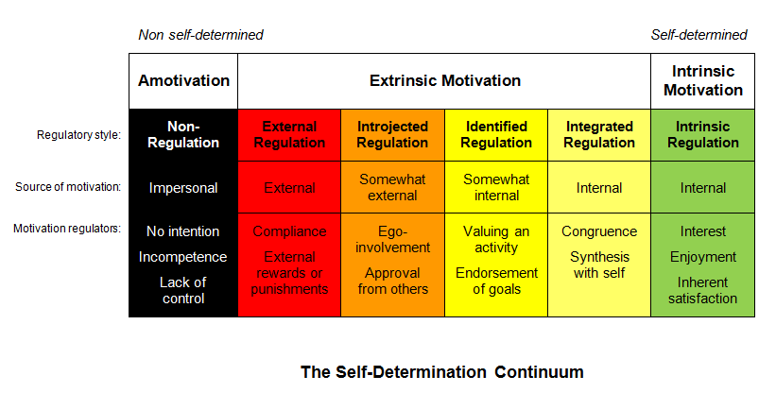
Notes:
Ralph

Slide 30
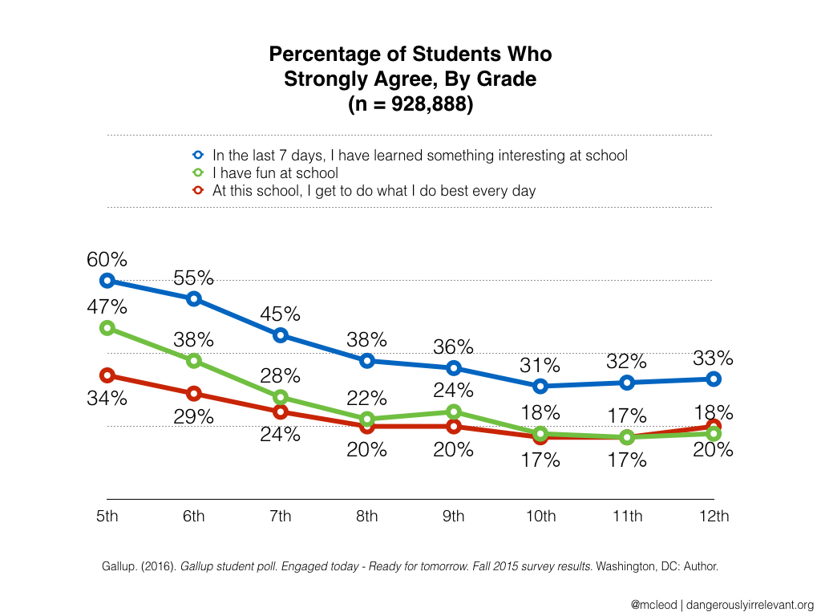

Slide 31
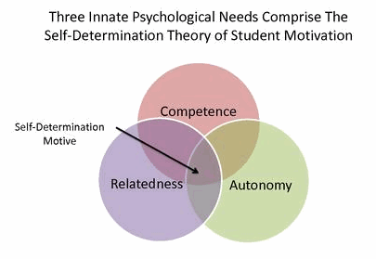
Self-Deterimination Theory
Cognitive Evaluation Theory
(Ryan & Deci, 2000)

Slide 32
Why would you care when making career decisions?
Quality task
Note:
You are all quality workers!
Performance
Quantity task
Intrinsic motivation
Source: Intrinsic motivation and extrinsic incentives jointly predict performance: A 40-year meta-analysis.
(Cerasoli, Nicklin, Ford 2014, N=212468, 183 studies)

Slide 33
A question to get in touch with your intrinsic motivation
Suppose you enjoy full financial independence.
You get something like 10,000 € / $ a month for the rest of your life. Tax-free : )
What are you going to do? How are you going to fill your days?
(after house - car - long, long holiday)
Give us some answers in the chat!
Notes:
Ralph & Chiat

Slide 34
PhD graduates identifying unexpected opportunities
A microbiologist who likes to keep things in check…
An astrophysicist into trains…
Combining education + development work + Africa ?!
Notes:
Chiat
Geen garantie, maar je kunt het toeval helpen

Slide 35
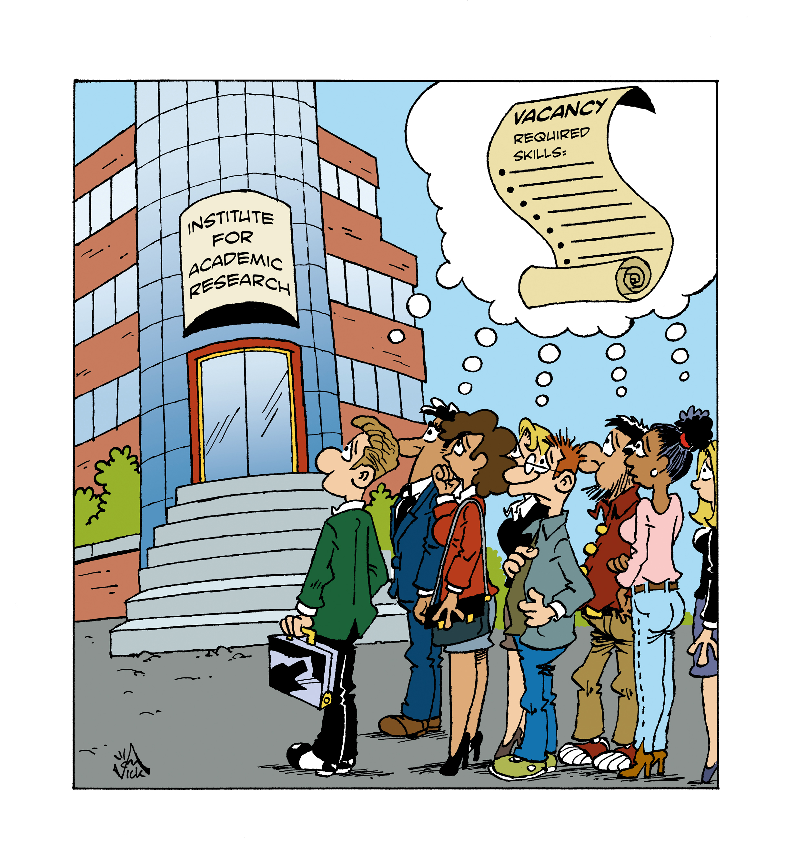
Where do you fit in?
Notes:
Chiat & Ralph

Slide 36

Where do you fit in?
Notes:
Chiat & Ralph

Slide 37
Where are you in this career quadrant?
Job focus (also) outside academia
Inventory transferable skills
4
1
Take a wider look
Only if you have to
Does not feel
competent
to work
outside
academia
Feels
competent
to work
outside
academia
3
2
Job focus only within academia
Notes:
Ralph & Chiat

Slide 38
A strategy for career orientation
Start timely:
PhD candidates : 1,5 - 1 year before PhD graduation
Postdocs : any time
Find out what you want.
What do you like / need / find important / are good at
What motivates you?
Use this profile to evaluate job vacancies
+ to ask around to identify new options/opportunities
Once you know what direction/job: Get prepared!
Notes:
Chiat

Slide 39
A strategy for career orientation
Start timely:
PhD candidates : 1,5 - 1 year before PhD graduation
Postdocs : any time
Find out what you want.
What do you like / need / find important / are good at
What motivates you?
Use this profile to evaluate job vacancies
+ to ask around to identify new options/opportunities
Once you know what direction/job: Get prepared!
find support

Slide 40
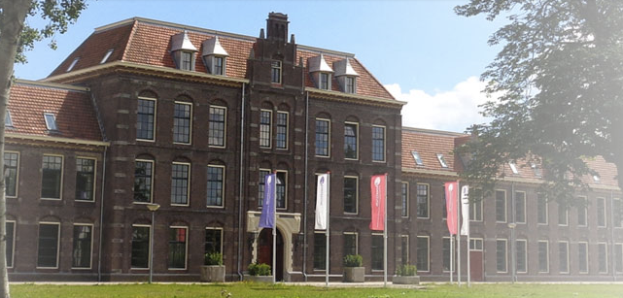
Mapping out your road as a science professional
A 2-day retreat for academic scientists (PhD candidates and up).
Analyze your motivational drive and possibilities to map your road ahead
Next edition: The Netherlands, 1hr from Schiphol airport on 7-8 March 2019
Still a couple of places available! (max. 20 participants)
More info:
mappingoutyourroad.com
Sign up for announcements of new editions
Powered by
Qia Consultancy & Training
Ralph Rousseau

Slide 41
Questions?

Slide 42
Thank you!
Wishing you all the best
on your future career!
Chiat Cheong qiaconsultancy@icloud.com
Ralph Rousseau
ralph@voixhumaines.com
….or contact us on LinkedIn

Slide 43
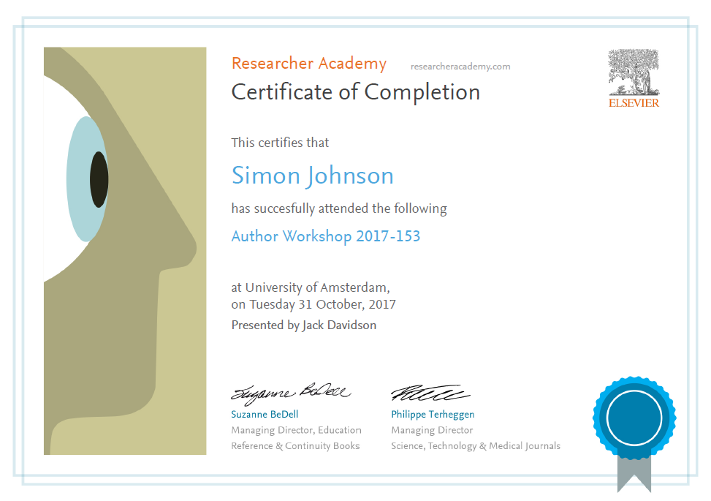
Thank you
Ask your questions on:
Researcher Academy Mendeley group
Follow us on Twitter

