Slide 1
The Lay Summary
Promote your work and make science accessible for all…
Elaine T. Kiriakopoulos, MD, MSc & Daniel Staemmler, PhD
19 March 2019

Slide 2

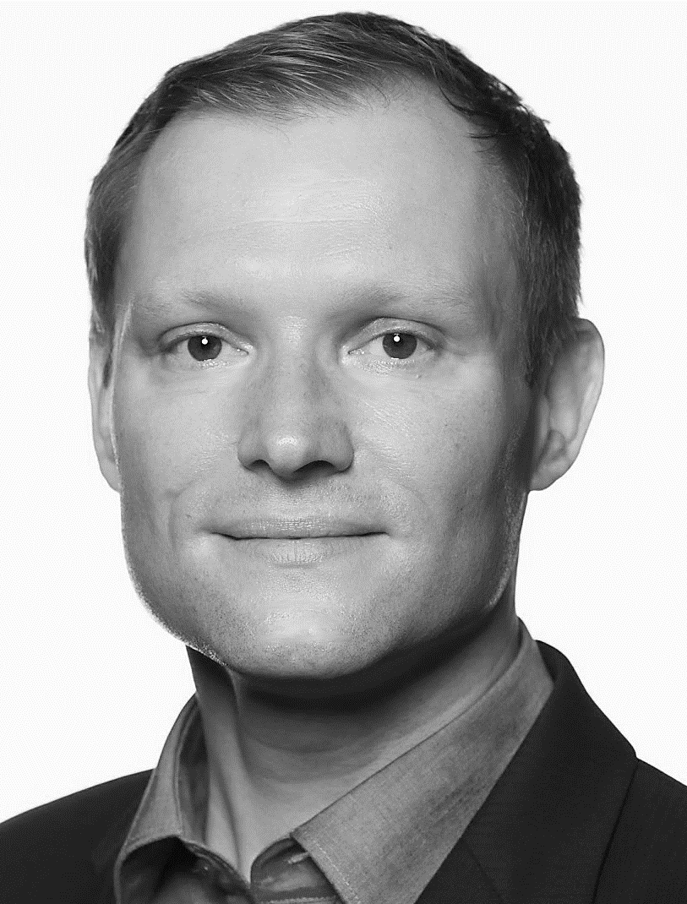
Guest Speakers
Elaine T. Kiriakopoulos, MD, MSc
Director, Health Communications & Engagement
Epilepsy Foundation
Daniel Staemmler, PhD
Executive Publisher in Health & Medical Sciences
STM Journal Publishing, Elsevier

Slide 3
WHAT?

Slide 4

A lay summary…
Makes research accessible to the general public.

Slide 5

A lay summary…
Engages new readers in science.

Slide 6

A lay summary…
Increases possibility…
… of collaboration

Slide 7

A lay summary…
Raises the visibility of scientific research.

Slide 8
HOW?

Slide 9
“Anything, even the conceptually most complex material, can be written for general audiences without any dumbing down. Of course you have to explain things carefully. This goes back to Galileo, who wrote his great books as dialogues in Italian, not a treatises in Latin. And to Darwin, who wrote The Origin of Species for general readers. I think a lot of people pick up Darwin’s book and assume it must be a popular version of some technical monograph, but there is no technical monograph. That’s what he wrote...”
-Stephen Jay Gould

Slide 10

YOUR STORY TO TELL...

Slide 11
SAMPLE LAY SUMMARY OUTLINE
Introduction
Purpose
Description of study
Summary of findings
What does this mean?

Slide 12

FIRST IMPRESSIONS
Open with take home message
Be up front and direct
what is most important to share?

Slide 13
A Randomized Controlled Trial of a Manual-based Psychosocial Group Intervention for Young People with Epilepsy (PIE)
Epilepsy is the most common serious childhood neurologic disorder. A diagnosis of epilepsy requires a young person to make psychological and behavioral adjustments to manage their epilepsy.
Research has demonstrated that young people with epilepsy have increased levels of depression and social anxiety, and decreased self-esteem. Studies also show that low levels of epilepsy knowledge correlate with more psychological problems in young people.
Group interventions may be an effective way to provide psychosocial care for young people with epilepsy.
WHY ARE WE HERE?
SAYS WHO?
SO WHAT?

Slide 14
AVOID SCIENCE JARGON
BLAH
LAH
BLAH
jargon is “insider vocabulary”
alienates and excludes audiences
avoid acronyms, abbreviations and complex terms
aim to educate people by explaining complex ideas in a simple way, not by explaining simple ideas in a complex way
your job : make science accessible
B
H
BLAH

Slide 15

UNBOX THE SCIENCE
Know your stuff
if you do not have a good understanding of the science you will not be able to explain it to others
Know your audience
write for the readers not your colleagues
target stakeholder needs
Know your limits
consider vehicle for sharing and plan accordingly
no one will complain that a writer makes something too easy to understand

Slide 16
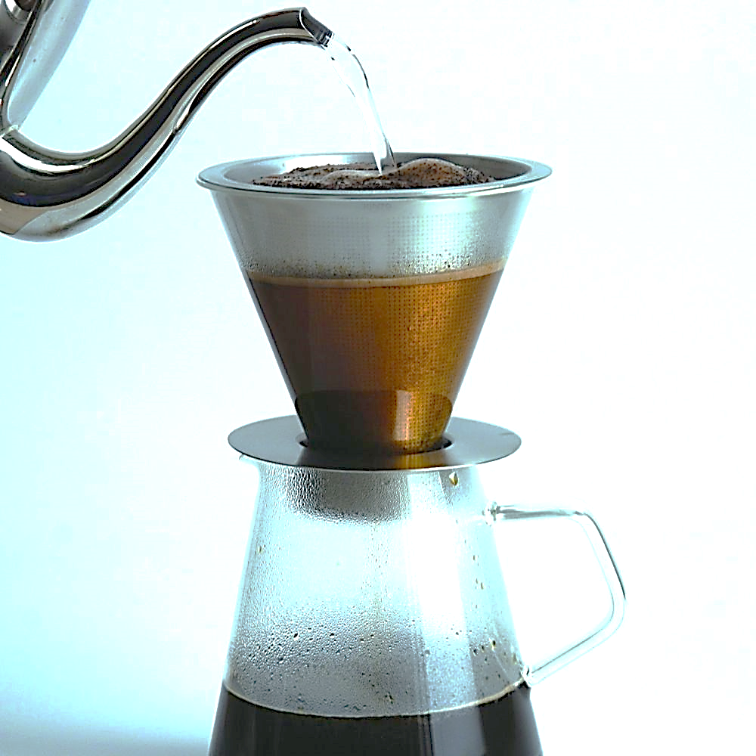
FILTER
science writing filled with detail
PRIORITIZE details you absolutely need to share, filter out the rest
only the ESSENTIALS
aim for your reader to exit with a real sense of the BIG PICTURE not baffled by the granular detail

Slide 17
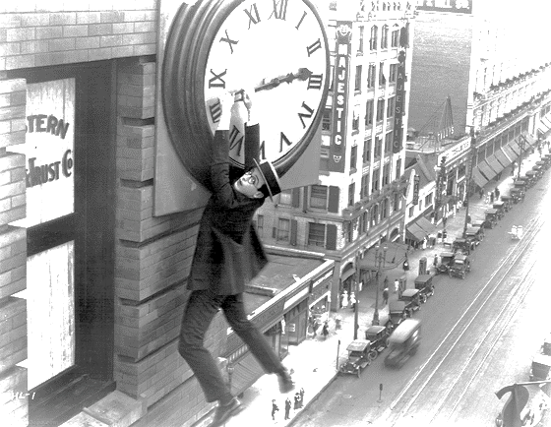
“CUT TO THE CHASE”
be concise
get to the point faster
eliminate flowery phrases and unnecessary preamble
visualize the data
efficiency keeps the reader engaged

Slide 18
EXAMPLES
It is undeniable and absolutely critical that…
We must…
There were eighteen rats that received antibiotic injections every 12 hours for 7 consecutive days.
The rats received antibiotics.
We performed a careful analysis of...
We analyzed..
As with all preclinical investigations, it is premature to conclude that either mefloquine or probenecid would be appropriate for use as antiepileptic therapies.
Mefloquine and probenecid are not yet proven epilepsy therapies.
MRI-guided laser interstitial therapy (MRg-LITT), also known as stereotactic laser ablation, uses laser energy to ablate neural tissue.
A laser can be used to remove abnormal brain tissue.

Slide 19

CONNECT : STORYTELLING
set the scene : where, who, how, and why the science was done
help readers understand how the
research impacts real people by
telling a story about real people
humans are hardwired for stories
discovery, impact: there is a place for drama and suspense in science

Slide 20
EXAMPLE : CONNECT
The impact of epilepsy will vary for each child and each family. An early diagnosis of epilepsy can bring extra needs and challenges that impact the wellbeing of a child…” “…challenges can significantly affect the way families function from day to day. Identifying needs, providing early treatment and ensuring a strong network of support for children and families facing these hurdles is critical to improving health outcomes and quality of life.
fb reader comment: “The opening paragraph is so validating. People don’t understand how many additional conditions there are and the impact it has on a family.”

Slide 21

THE FUTURE
describe potential impact of the study
action items based on the research presented in your summary
beyond the here and now: what the future holds

Slide 22
EXAMPLE : ACTION ITEM
This study provides information that supports how epilepsy in young children can have a wide range of impact on families.
Sharing concerns about your child’s overall health and wellbeing with their epilepsy doctor or nurse will ensure the appropriate assessments, treatments, and supports are in place.”

Slide 23

SHARPEN YOUR SKILLS
read other science writers work
listen to science podcasts
plentiful practice
step away from the science and consider a writing or storytelling class

Slide 24
“Science is an integral part of culture. It’s not this foreign thing, done by an arcane priesthood. It’s one of the glories of human intellectual tradition.”
- Stephen Jay Gould

Slide 25
WHERE?

Slide 26
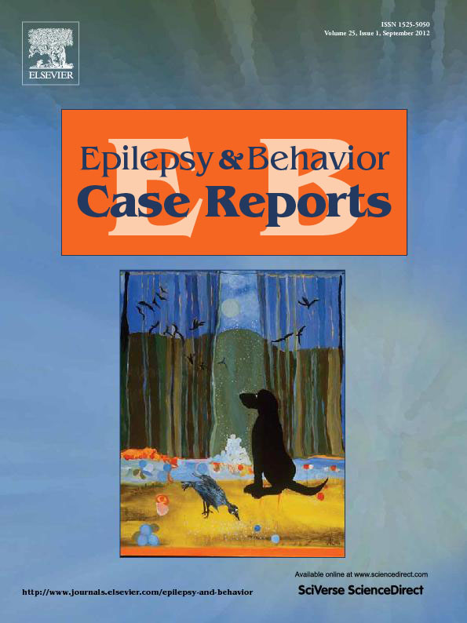
THE PATH TO PUBLICATION
Case report accepted
Email: Explain your research in 100 words
Read by novice and if approved…
Posted on journal homepage
https://www.elsevier.com/locate/ebcr

Slide 27
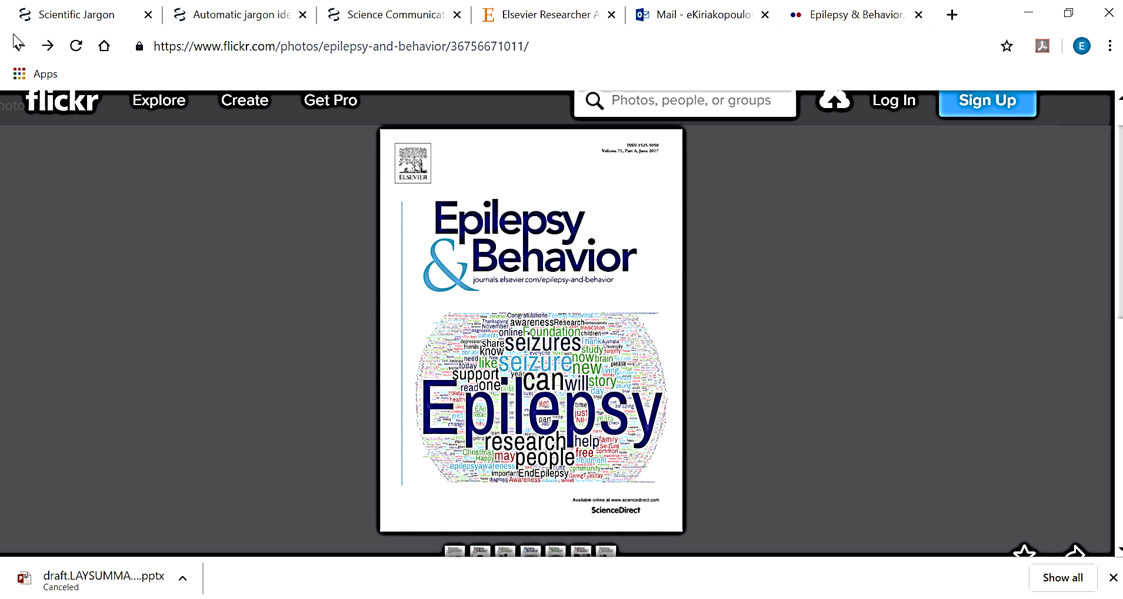
WHERE LAY SUMMARIES LIVE?
Epilepsy & Behavior
Epilepsy Foundation www.epilepsy.com
Collaborative effort to share science
address stakeholder needs

Slide 28




WHERE DO LAY SUMMARIES APPEAR?

Slide 29
WHY?

Slide 30
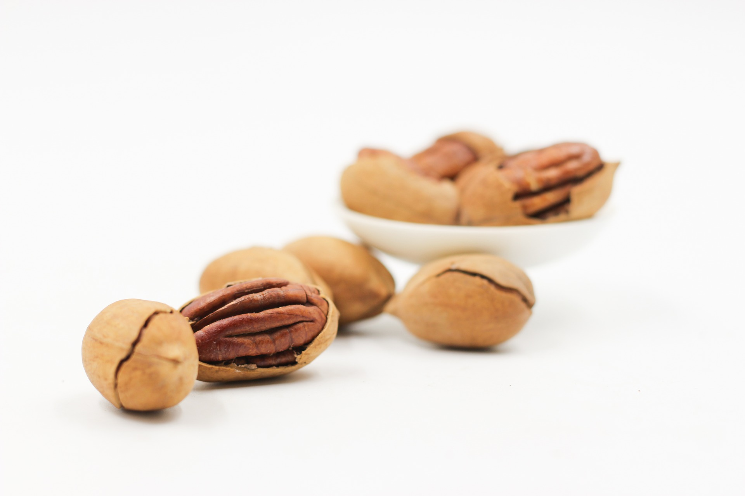
IN A NUTSHELL : THE BENEFITS

Slide 31
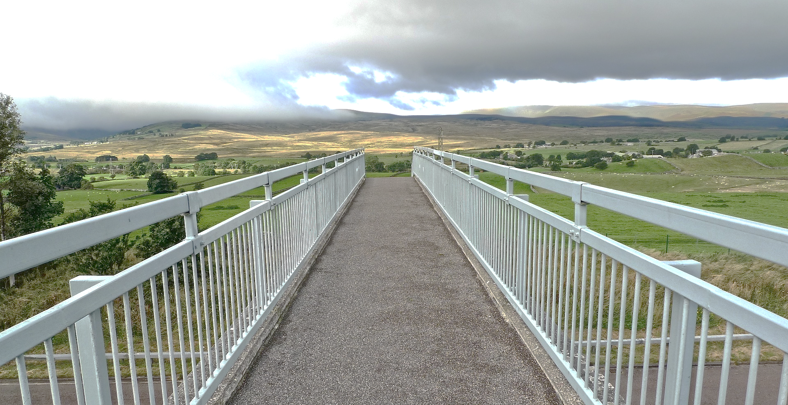
Broaden the impact of your research…

Slide 32

Unlock new collaborations...

Slide 33

Support your application for funding…

Slide 34

Public Relations

Slide 35
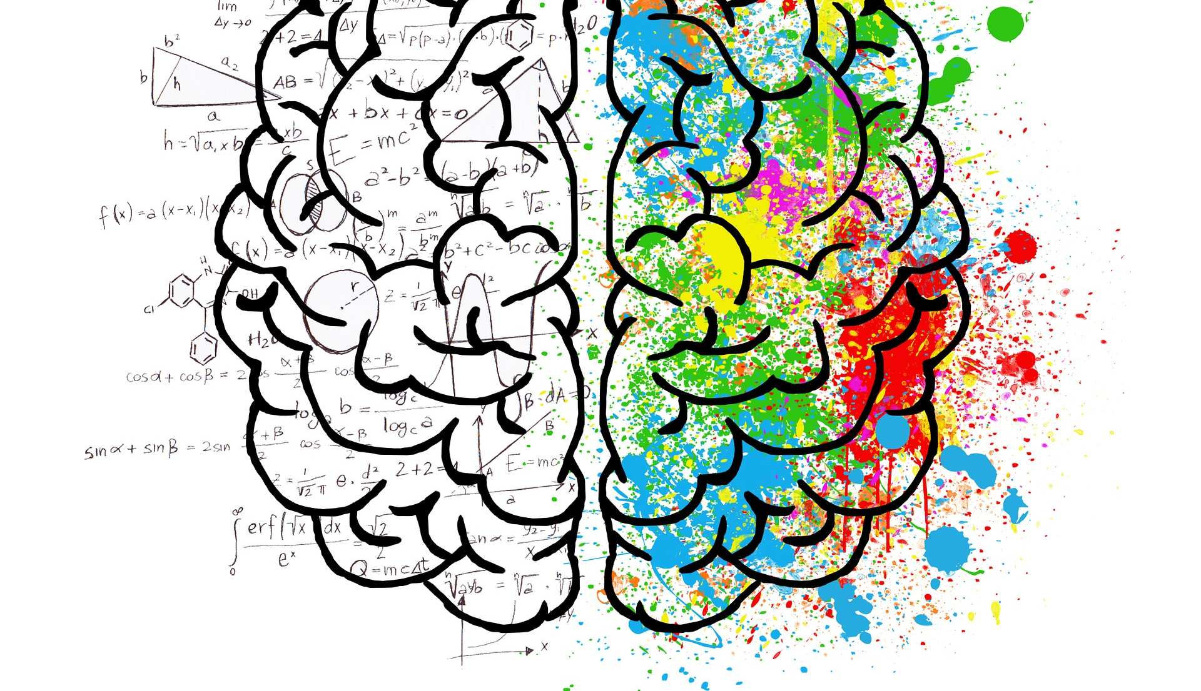
New routes to your scientific discovery…

Slide 36

Societal Impact
Advocacy and Public Policy

Slide 37
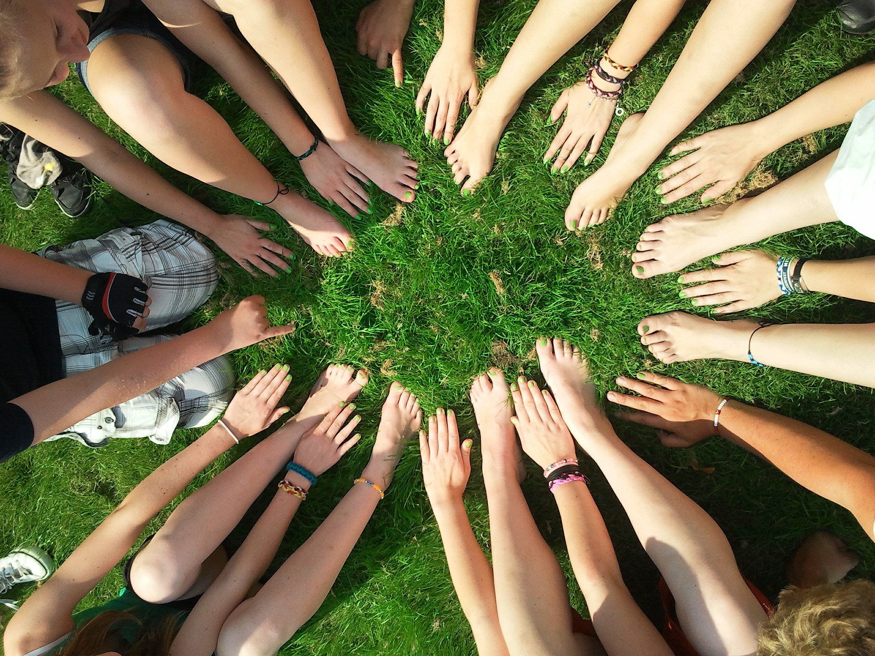
Change Outcome for Individuals

Slide 38
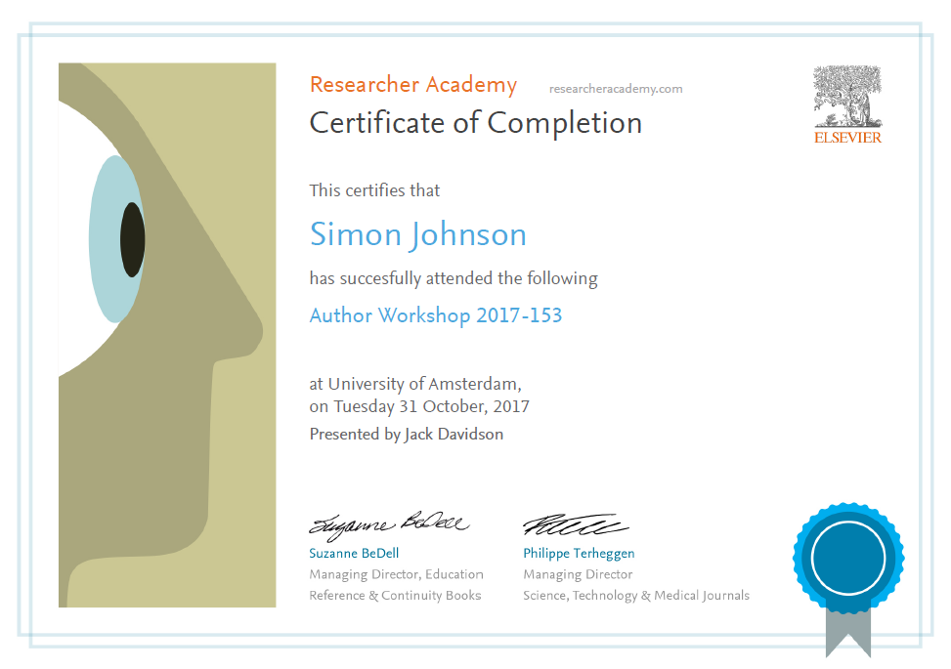
Thank you!
Ask your questions on:
Researcher Academy Mendeley group
Follow us on Twitter

