Slide 1
Tips for writing grant applications – a funder perspective
A better understanding of what to consider when writing a grant application
Annalisa Montesanti, PhD
Health research Board, Ireland
29 May 2019

Slide 2
About the speaker
Annalisa Montesanti is currently managing the Health Research Careers portfolio. She is responsible for developing and managing a portfolio of training and career development to develop a coordinated approach to building capacity and support a highly skilled workforce in health research in Ireland.

Slide 3
What we will focus on
Before you start writing
Know your funder
Know your audience
What reviewers look for
Before you submit
Use the right to respond
Be aware of research governance issues
Common failings
Key factors for a successful application

Slide 4
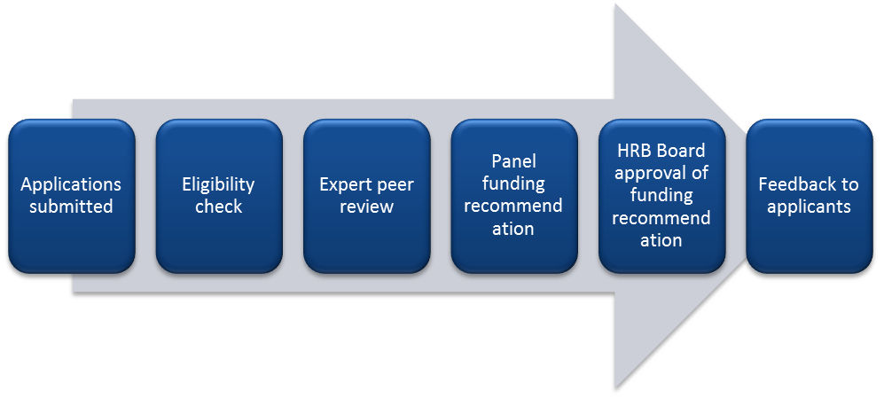
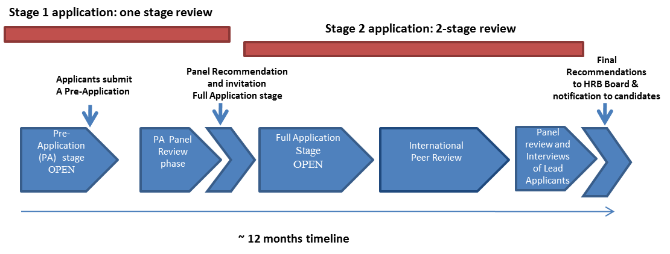
Assessment of applications

Slide 5
Before you start writing
Know your target funding stream
Read the Guidance Notes specific to the scheme
Confirm scheme is appropriate for your career stage and you meet eligibility criteria
If unsure whether the research is in scope/scheme appropriate to your career stage don’t hesitate to contact the Project Officer for the scheme
Seek advice from colleagues, potential co-applicants, specialists, etc
Allow enough time
Understand the assessment process and write with this in mind
Assemble a strong team and choose collaborators carefully

Slide 6
Know the funder you are seeking funding from
Read the corporate strategy
Look at the Mission, Vision and Values
Look at the funder’s website, e.g. position statements and policies

Slide 7
Be aware of the research governance issues
Ethical issues –the need to have research ethics committee approval
Are you working to a code of Good Research Practice
Have you thought about Intellectual Property Rights
Have you considered Data Protection and confidentiality
Do you have indemnity cover where needed

Slide 8
Know your audience
You will need to convince experts in your field/area/methodology (international peer reviewers) and a mixed audience from a variety of scientific backgrounds (the panel)
Write the lay summary for the layperson
Explain well the context in Ireland with international reviewers in mind, e.g. provide figures for incidence/prevalence
Avoid abbreviations and acronyms and jargons

Slide 9
Before you submit
Edit, proofread and make sure all sections are complete
Ask co-applicants to review the application and ensure that their input is covered appropriately
Make sure to submit a clean version
Ensure all related supporting documentation is included
Ask a colleague to comment on readability and flow
Be aware of deadlines where you are asking others for input
Leave time to discuss and finalise the budget section with your Research Office (or equivalent) at the host institution

Slide 10
Use the right to respond, if applicable
Be succinct yet clear and comprehensive and follow the guidelines (e.g. word count)
Acknowledge all significant concerns and/or weaknesses described in feedback
If the applicant team disagrees with a reviewer’s statement explain clearly why
Acknowledge and discuss the implications of taking on board some of the feedback (e.g., for applicant team, research personnel, cost, timelines, methods)
Avoid coming across as argumentative or overly defensive
Do not propose to change significantly the application following the peer-reviewers comments

Slide 11
Prepare for interview, if applicable
Follow the guidelines provide to you before the interview, e.g. what to address in the presentation
Time keeping for a presentation, e.g. 10 minutes.
Prepare for the presentation several times in front of an audience
Know the most recent literature from the time of submitting the application
Show you have thought of the peer-reviewers comments and you can address some and why.
Show ownership of your project.

Slide 12
What are the reviewers looking for (1)
An important research area where original thinking and innovation in the project is highlighted (where relevant)
A well-written and clearly presented application
Timeliness of the topic
Identifiable deliverables within the required timeframe
Attention to detail – e.g. spellcheck complete
An ambitious proposal but not overly ambitious so as not to be possible within the timelines and/or resources available
The candidate has a clear and well through training plan, if applicable
The candidate has a clear vision of his/her career progression, e.g. Where do you want to be in 10 years and how will you get there?

Slide 13
What are the reviewers looking for (2)
Appropriate track record in research and demonstrates the necessary breadth and depth of expertise in all methodological areas required to deliver the research proposed
Evidence of appropriate consultation, partnerships and collaborations
A convincing research design with appropriate research methods
A feasible plan where potential problems are identified, discussed and alternative plans are also discussed
Evidence of meaningful public and patient involvement, where applicable
There is an appropriate dissemination plan

Slide 14
Examples of common failings (1)
Failure to demonstrate importance of the topic or new or original ideas
Research question is ill-identified, unfocused or unsupported by preliminary data
The study as designed will not answer the research question
Theoretical or conceptual underpinning of the study is weak or poorly articulated
Lack of clarity over objectives or outcomes measures
Project is overly ambitious and not feasible within timeframe or available budget
Incomplete or poor literature review where critical references are omitted

Slide 15
Examples of common failings (2)
Research staff proposed will not deliver
Applicant team is missing critical skills or expertise (most common omissions are statistician, clinical trialist, qualitative researcher, behavioural scientist, health economist)
Insufficient methodological details are provided
Intended users of a product or process are not involved in the development
Concerns over sample size
No discussion of possible problems/limitations and no contingency plan
Lack of a convincing dissemination plan

Slide 16
Examples of common failings (3)
Career development schemes – especially at interview stage
Lack of ownership of the project
Lack of understanding of the methodologies to be applied
Lack of research vision and clear career plans in
Training and development plan not well thought out
Lack of appropriate mentorship

Slide 17
Key factors to a successful application
Read carefully the guidance notes
Ask advise to your peers, collaborators, mentor. If necessary carry out an informal peer-review.
Ask questions to the the funder staff managing the scheme (e.g. project officer, programme manager)
Talk to others who have succeeded in the scheme
Prepare well for interview. Ask colleagues to help with mock interviews
Write the application with your reviewers in mind

Slide 18
Thank you.
Ask your questions on:
Researcher Academy Mendeley group
Follow us on Twitter

