Slide 1
An Editor’s Guide to Writing a Review
Presentation by Matthew Pavlovich & Lindsey Drayton
27 June 2019

Slide 2
About the speakers
Matt Pavlovich is the editor of Trends in Biotechnology, Cell Press’s home for reviews in applied biology. He earned his BS in chemical engineering from the Georgia Institute of Technology and his PhD in chemical engineering from the University of California at Berkeley, where his thesis project focused on the biological effects of air plasmas. He studied analytical chemistry as a postdoctoral researcher at Northeastern University, then joined Cell Press at the start of 2016.
Lindsey Drayton is the editor of Trends in Cognitive Sciences, Cell Press’s home for reviews in cognitive psychology and cognitive neuroscience. She earned her BA in Psychology from Duke University and her PhD in Psychology from Yale University. At Yale, she studied the evolution and ontology of human social cognition using a variety of model primate species. She joined Cell Press in 2017.

Slide 3
Why are reviews useful?

Slide 4

Why are reviews useful?
They organize, evaluate, and distill information

Slide 5

Why are reviews useful?
They organize, evaluate, and distill information
They are an entry point for students and policy makers

Slide 6
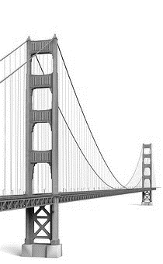
Why are reviews useful?
They organize, evaluate, and distill information
They are an entry point for students and policy makers
They provide a bridge between fields

Slide 7

Why are reviews useful?
They organize, evaluate, and distill information
They are an entry point for students and policy makers
They provide a bridge between fields
They direct and shape future research

Slide 8
Why write a review?

Slide 9
Why write a review?
Not So Good Reasons

Slide 10
Why write a review?
Not So Good Reasons
  You want to learn about a new subfield

Slide 11
Why write a review?
Not So Good Reasons
  You want to learn about a new subfield
  Its seems like an easy way to get another line on your CV

Slide 12
Why write a review?
Not So Good Reasons
  You want to learn about a new subfield
  Its seems like an easy way to get another line on your CV
Practical Reasons

Slide 13
Why write a review?
Not So Good Reasons
  You want to learn about a new subfield
  Its seems like an easy way to get another line on your CV
Practical Reasons
  It’s an opportunity to demonstrate expertise in your subfield

Slide 14
Why write a review?
Not So Good Reasons
  You want to learn about a new subfield
  Its seems like an easy way to get another line on your CV
Practical Reasons
  It’s an opportunity to demonstrate expertise in your subfield
  On average, reviews are cited and downloaded more than primary research articles

Slide 15
Why write a review?
Not So Good Reasons
  You want to learn about a new subfield
  Its seems like an easy way to get another line on your CV
Practical Reasons
  It’s an opportunity to demonstrate expertise in your subfield
  On average, reviews are cited and downloaded more than primary research articles
  It’s an opportunity to think deeply about the state of your subfield

Slide 16
Why write a review?
Not So Good Reasons
  You want to learn about a new subfield
  Its seems like an easy way to get another line on your CV
Practical Reasons
  It’s an opportunity to demonstrate expertise in your subfield
  On average, reviews are cited and downloaded more than primary research articles
  It’s an opportunity to think deeply about the state of your subfield
Good Reasons

Slide 17
Why write a review?
Not So Good Reasons
  You want to learn about a new subfield
  Its seems like an easy way to get another line on your CV
Practical Reasons
  It’s an opportunity to demonstrate expertise in your subfield
  On average, reviews are cited and downloaded more than primary research articles
  It’s an opportunity to think deeply about the state of your subfield
Good Reasons
A Great Reason
  You can provide an insight that cannot be directly obtained from reading the primary empirical literature

Slide 18
Thinking about the content: Basics
What is the central thesis?
Why does this matter?
Why does this matter now?
What is the tone?
Who is the audience?
Is it positioned distinctly from other reviews?

Slide 19
Don’t I need to be invited to write a review?
Understand the journal’s model
  Direct submission (not all journals allow this; impossible at Trends journals)
  Invited or “commissioned” only
  Are unsolicited proposals considered? Yes! (at least at Trends and many other Cell Press journals)
  If you aren’t sure, ask the editor

Slide 20
Don’t I need to be invited to write a review?
Understand the journal’s model
  Direct submission (not all journals allow this; impossible at Trends journals)
  Invited or “commissioned” only
  Are unsolicited proposals considered? Yes! (at least at Trends and many other Cell Press journals)
  If you aren’t sure, ask the editor
What’s all this about presubmission inquiries?
  Publishing jargon for “should I bother to submit this to your journal?”
  Research: suitability of an already-conducted study for that journal
  Review: exactly the same thing as an article proposal

Slide 21
Can’t I just send the whole manuscript?
Again, understand the journal’s model
  Some journals are okay with this
  Most Trends journals strongly prefer proposals

Slide 22
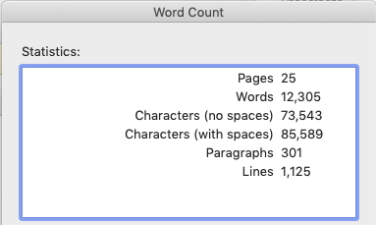
Can’t I just send the whole manuscript?
Again, understand the journal’s model
  Some journals are okay with this
  Most Trends journals strongly prefer proposals
Why?
  We don’t want you to waste your time on
  something out of scope or format
  Editor’s job is to help you make the tone and content a good fit

Slide 23
Can’t I just send the whole manuscript?
Again, understand the journal’s model
  Some journals are okay with this
  Most Trends journals strongly prefer proposals
Why?
  We don’t want you to waste your time on
  something out of scope or format
  Editor’s job is to help you make the tone and content a good fit
  Steady state: these boxes should all be the same size
Invited to submit
Invited to submit
Invited to submit
Submitted and under review
Reviewed and in revision
Accepted and in production
Appearing online ahead of print
Published in an issue
Invited
April-June 2019
Invited
March 2019
Invited February 2019
Invited
January 2019
Invited
December 2018
Invited
November 2018

Slide 24
Can’t I just send the whole manuscript?
Again, understand the journal’s model
  Some journals are okay with this
  Most Trends journals strongly prefer proposals
Why?
  We don’t want you to waste your time on
  something out of scope or format
  Editor’s job is to help you make the tone and content a good fit
  Steady state: these boxes should all be the same size
“Cutting in line” can have downstream effects!
Invited to submit
Invited to submit
Invited to submit
Submitted and under review
Reviewed and in revision
Accepted and in production
Appearing online ahead of print
Published in an issue
Invited
April-June 2019
Invited
March 2019
Invited February 2019
Invited
January 2019
Invited
December 2018
Invited
November 2018

Slide 25
What to include in a proposal
#1 rule: follow the intended journal’s formatting
  Should be available on the journal’s website, but if not, ask the editor
  Yes, even if the first place you submitted the proposal asked for a different format
  Yes, we notice

Slide 26
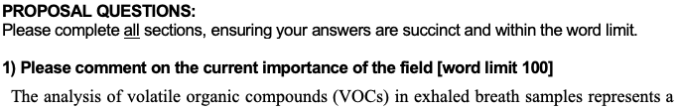
What to include in a proposal
#1 rule: follow the intended journal’s formatting
  Should be available on the journal’s website, but if not, ask the editor
  Yes, even if the first place you submitted the proposal asked for a different format
  Yes, we notice
  Example of a proposal sent to me in different journal’s proposal style:

Slide 27
What to include in a proposal
#1 rule: follow the intended journal’s formatting
  Should be available on the journal’s website, but if not, ask the editor
  Yes, even if the first place you submitted the proposal asked for a different format
  Yes, we notice
  Example of a proposal sent to me in different journal’s proposal style:
But there do tend to be similarities in the kinds of information that editors are looking for

Slide 28
What to include in a proposal
Include everything you just heard about, in a clear, succinct manner
Must haves
  Format (Review vs. Opinion vs. short article)
  Authors and affiliations
  Summary of the scientific content (extended abstract and/or outline)
  Why is it timely and why should we be interested?
  Are there other reviews on this topic, and if so, how is yours different?
  What is your personal expertise on the topic and what novel perspective can you include?
  What are some key references on the topic?

Slide 29
What to include in a proposal
Include everything you just heard about, in a clear, succinct manner
Must haves
  Format (Review vs. Opinion vs. short article)
  Authors and affiliations
  Summary of the scientific content (extended abstract and/or outline)
  Why is it timely and why should we be interested?
  Are there other reviews on this topic, and if so, how is yours different?
  What is your personal expertise on the topic and what novel perspective can you include?
  What are some key references on the topic?
Feel free, but not compelled, to also include
  Figure drafts or legends
  Approximate word count
  Your own publication history in the field

Slide 30
What if the editor says no?
Doesn’t mean your proposal was bad
  Other reviews forthcoming
  Field isn’t ripe enough yet
  Out of scope
  Saving space for invitations (e.g., upcoming conference travel)
  Would benefit from additional author expertise
  Pipeline too full to add anything new

Slide 31
What if the editor says no?
Doesn’t mean your proposal was bad
  Other reviews forthcoming
  Field isn’t ripe enough yet
  Out of scope
  Saving space for invitations (e.g., upcoming conference travel)
  Would benefit from additional author expertise
  Pipeline too full to add anything new
Not necessarily the end of the line
  Revise the aim of the review to add novelty or adjust scope
  Change format (e.g., to a short article)
  Come back in a few months
  Invite another co-author or two

Slide 32
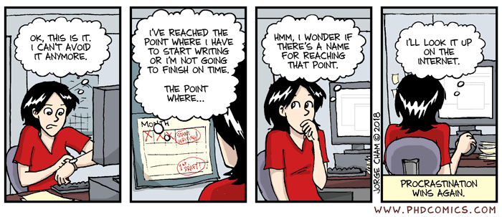
Getting down to writing
PhD Comic #2019, copyright Jorge Cham

Slide 33
Organization
Start with an outline
We like 4-6 main sections
  And perhaps 2-3 subsections in some of those main sections
  But don’t subdivide the introductory or concluding sections
Use parallel structure in headings
  Help organize information sensibly
  Ensure you’re giving adequate attention to all aspects of the review
  Good subsection length: 2-4 paragraphs
  Shorter sections, don’t subdivide; longer sections, make into 2 main sections
In other words, don’t have four subsections in one main section and one in the next
  Because it looks silly and it doesn’t make sense to divide one thing into one part, or a short section into a bunch of shorter paragraphs

Slide 34
Make sure you’re saying something new
A review is not a collection of results
Readers should learn something they couldn’t get just by reading the references
  Comparison, critique, assessment—including of your own work
  Synthesis of disparate ideas
  Actual ideas for future experiments (not just “future work is needed”)
  Path to translation, market, industrial scale-up

Slide 35
Make sure you’re saying something new
A review is not a collection of results
Readers should learn something they couldn’t get just by reading the references
  Comparison, critique, assessment—including of your own work
  Synthesis of disparate ideas
  Actual ideas for future experiments (not just “future work is needed”)
  Path to translation, market, industrial scale-up
Manage reader expectations
  Tell your readers why this is timely and why you’ve chosen to write this review right now
  Your review will probably not be exhaustive, and that’s okay
  Acknowledge other reviews and explain why yours is different

Slide 36
Make sure you’re saying something new
A review is not a collection of results
Readers should learn something they couldn’t get just by reading the references
  Comparison, critique, assessment—including of your own work
  Synthesis of disparate ideas
  Actual ideas for future experiments (not just “future work is needed”)
  Path to translation, market, industrial scale-up
Manage reader expectations
  Tell your readers why this is timely and why you’ve chosen to write this review right now
  Your review will probably not be exhaustive, and that’s okay
  Acknowledge other reviews and explain why yours is different
The pesky concluding section
  Is it one paragraph where every sentence starts “In this review, we have demonstrated”?
  Or, is there a brilliant thesis statement buried in the second-to-last sentence?

Slide 37
Consistency and accessibility
Avoid jargon
  The broader the journal’s scope, the harder this is
  If you have the option to include a Glossary, do it
  Make sure definitions conform with accepted meanings
  Make sure terms are used consistently throughout

Slide 38
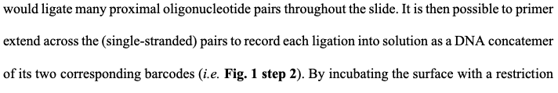
Consistency and accessibility
Avoid jargon
  The broader the journal’s scope, the harder this is
  If you have the option to include a Glossary, do it
  Make sure definitions conform with accepted meanings
  Make sure terms are used consistently throughout
You’re an expert—that’s why you’re writing a review—but don’t assume every reader knows as much as you do

Slide 39
Does it meet journal requirements?
There might—or might not—be some flexibility in word count and number of references
  Probably safe to assume that if you’re 50% over stated limits, you’re going to need to cut down
  Possibly different standards for initial submission and revised version
  If you’re unsure about limit strictness, ask the editor
Minor formatting requirements (reference formatting, figure call-outs, etc.) might be addressed later
  Saves you, the reviewers, the editor, and the production team a lot of time to fix it now
  Copyediting/typesetting for accepted manuscripts can vary by journal

Slide 40
Now, read the whole thing again
Don’t submit the first draft
Read from start to finish
  Especially if there are multiple authors involved who each wrote one section
  Do transitions make sense?
  Take the perspective of the reader
Are you missing something?
  Figure call-outs
  Acronyms spelled out
  Other required elements (Trends: Outstanding Questions, etc.)

Slide 41
Revising the manuscript
The editor is here to help your paper succeed
  Thought it was a good idea to start with
  Substantial time and energy investment by now
  We will offer suggestions for how to respond to reviewer concerns
Really engage with reviewer comments
  Don’t just superficially do what they say
  “Rewrite this section” doesn’t mean “clean up a few sentences”
Review manuscripts are not always sent back to reviewers, though policies are different at different journals
Ask the editor if you have questions!

Slide 42
Top 10 Take-Aways

Slide 43
Top 10 Take-Aways
A review is not a list of results

Slide 44
Top 10 Take-Aways
A review is not a list of results
Only write a review if you feel you have something to say

Slide 45
Top 10 Take-Aways
A review is not a list of results
Only write a review if you feel you have something to say
If possible, submit a proposal before writing the manuscript

Slide 46
Top 10 Take-Aways
A review is not a list of results
Only write a review if you feel you have something to say
If possible, submit a proposal before writing the manuscript
In the proposal, make clear why the topic is important, why it is important now, and why you should write it

Slide 47
Top 10 Take-Aways
A review is not a list of results
Only write a review if you feel you have something to say
If possible, submit a proposal before writing the manuscript
In the proposal, make clear why the topic is important, why it is important now, and why you should write it
Know what journey you want to take your readers on

Slide 48
Top 10 Take-Aways
A review is not a list of results
Only write a review if you feel you have something to say
If possible, submit a proposal before writing the manuscript
In the proposal, make clear why the topic is important, why it is important now, and why you should write it
Know what journey you want to take your readers on
Manage readers’ expectations from the beginning

Slide 49
Top 10 Take-Aways
A review is not a list of results
Only write a review if you feel you have something to say
If possible, submit a proposal before writing the manuscript
In the proposal, make clear why the topic is important, why it is important now, and why you should write it
Know what journey you want to take your readers on
Manage readers’ expectations from the beginning
Avoid jargon

Slide 50
Top 10 Take-Aways
A review is not a list of results
Only write a review if you feel you have something to say
If possible, submit a proposal before writing the manuscript
In the proposal, make clear why the topic is important, why it is important now, and why you should write it
Know what journey you want to take your readers on
Manage readers’ expectations from the beginning
Avoid jargon
Expect to heavily revise the first draft

Slide 51
Top 10 Take-Aways
A review is not a list of results
Only write a review if you feel you have something to say
If possible, submit a proposal before writing the manuscript
In the proposal, make clear why the topic is important, why it is important now, and why you should write it
Know what journey you want to take your readers on
Manage readers’ expectations from the beginning
Avoid jargon
Expect to heavily revise the first draft
Follow the journal’s formatting guidelines

Slide 52
Top 10 Take-Aways
A review is not a list of results
Only write a review if you feel you have something to say
If possible, submit a proposal before writing the manuscript
In the proposal, make clear why the topic is important, why it is important now, and why you should write it
Know what journey you want to take your readers on
Manage readers’ expectations from the beginning
Avoid jargon
Expect to heavily revise the first draft
Follow the journal’s formatting guidelines
Remember, if you’ve been invited to submit a review, the editor wants you to succeed!

Slide 53
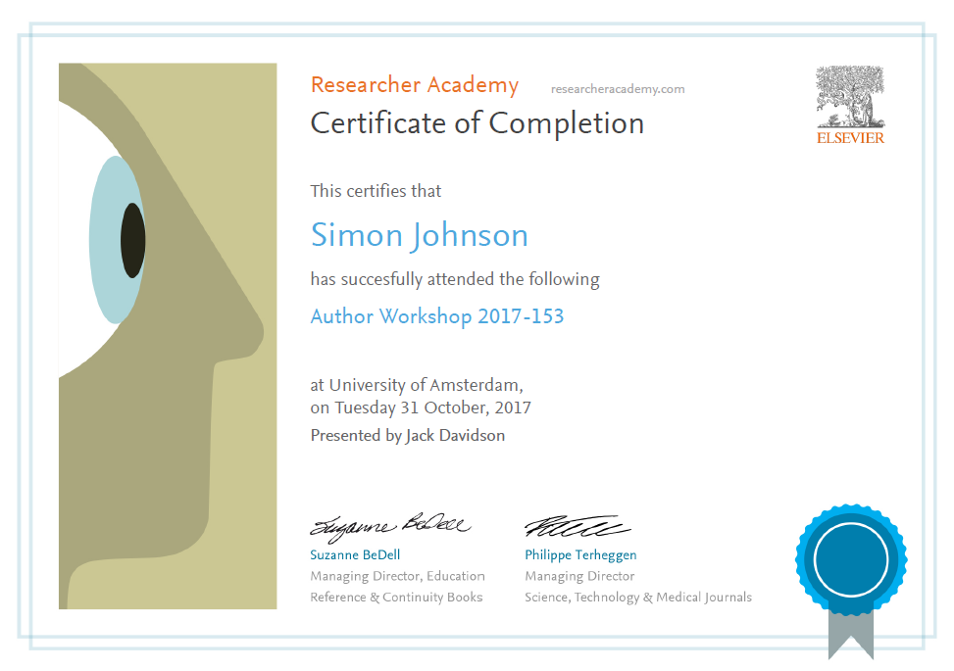
Thank you.
Ask your questions on:
Researcher Academy Mendeley group
Follow us on Twitter

