Slide 1
An introduction to peer review
Exploring the origins, processes and motivations of refereeing
Presented by Christopher Tancock, Senior Communications Manager, Elsevier Ltd
April 2019

Slide 2
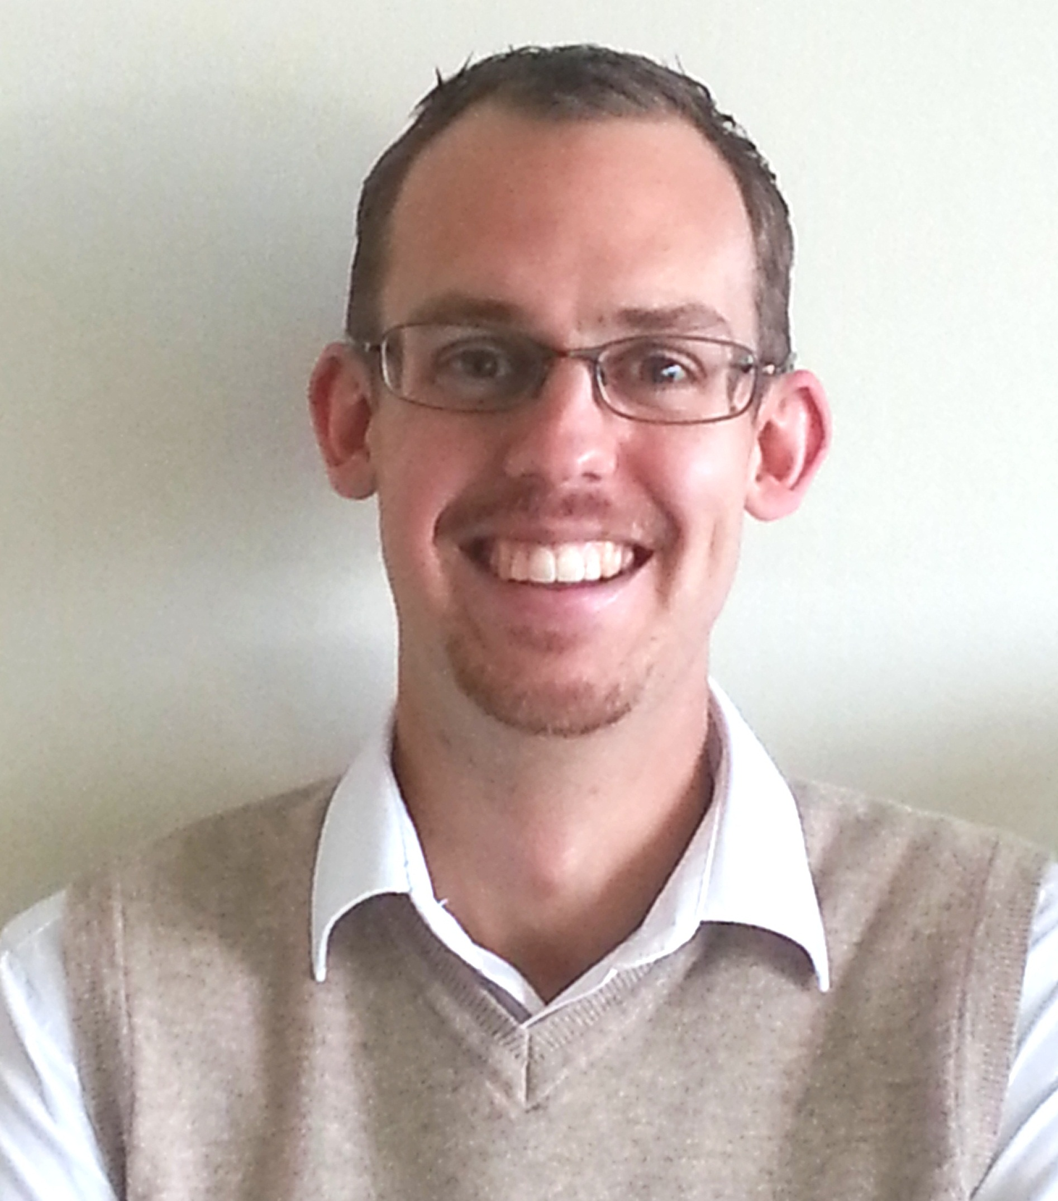
About the speaker
Christopher Tancock
Senior Communications Manager
Elsevier Ltd., Oxford, UK | c.tancock@elsevier.com

Slide 3
Contents
Section 1.1: What is peer review? Why peer review?
a. A brief history of academic publishing
b. Status quo of peer review and its trends
c. Explaining the editorial and peer review processes
d. What will have happened to the paper before you see it
e. Why reviewers review
f. What editors look for/the perfect reviewer

Slide 4
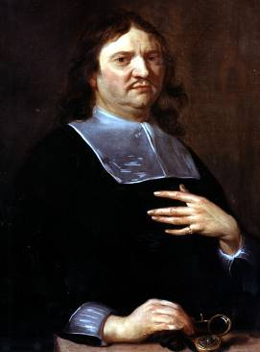
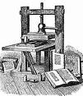
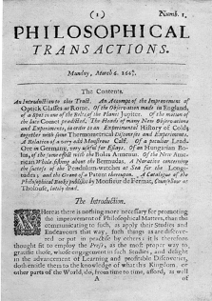
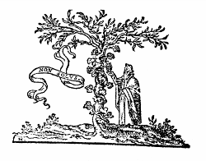
A brief history of academic publishing
1439
Gutenberg and Moveable Type
Henry Oldenburg
(1618- 1677)
Founding Editor
and Commercial
Publisher of the
first scientific
journal
1580
Founding of the House of Elzevir
6th March 1665
“Philosophical Transactions
of the Royal Society”
First true scholarly journal

Slide 5
Functions of scholarly publishing
The timestamp to officially note who submitted scientific results first
Registration
Perform peer-review to ensure the validity and integrity of submissions
Certification
Dissemination
Provide a medium for discoveries and findings to be shared
Preserving the minutes and record of science for posterity
Preservation

Slide 6
How do these functions look today?
Registration
Certification
Dissemination
Preservation
Use
What roles do modern publishers play?
Innovation & Technology

Slide 7
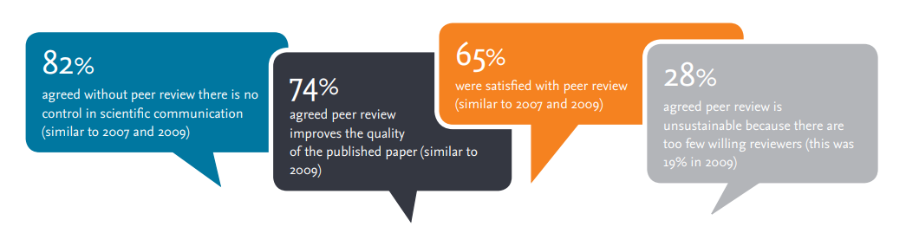
Status quo of peer review and its trends
Source: 2015 study carried out by Elsevier’s Customer Insights team in collaboration with the PRC (Publishing Research Consortium)

Slide 8
Explaining the editorial and peer review processes
Peer review places the reviewer, with the author, at the heart of scientific publishing
Reviewers make the editorial process work by examining and commenting on manuscripts
Without peer review there is no control in scientific communication
Reviewers are the backbone of the whole process

Slide 9
The peer review process
Author submits article to journal
Source: Peer review: the nuts and bolts,
Sense About Science, 2012
Journal Editor screens paper
Rejected after screening
Reviewer
Reviewer
Rejected
Makes revisions
Editor assessment of reviews
Accepted no revisions required

Slide 10

So what does peer review actually do?
Improves quality of the published paper
Ensures previous work is acknowledged
Determines the importance of findings
Assesses the originality and significance of the work
Highlights any omissions in the reference list and any ethics concerns

Slide 11
What will have happened to the paper before you see it
Author submits article to journal
Journal Editor screens paper
Rejected after screening
Reviewer
Reviewer
Rejected
Makes revisions
Editor assessment of reviews
Accepted no revisions required

Slide 12
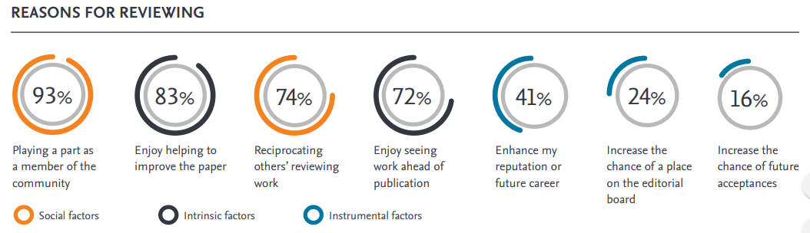
Why reviewers review
Value from mentoring younger/less experienced researchers
Enjoyment in reviewing
General interest in the area
Awareness of new research and developments before their peers
Career development
Help develop own research or new ideas
Association with journals and editors
Keep updated with latest developments
Source: 2015 study carried out by Elsevier’s Customer Insights team in collaboration with the PRC (Publishing Research Consortium)

Slide 13


What editors look for/the perfect reviewer
Working in the right area
No conflict of interest
Enthusiastic!
Experienced
Available
Timely
Effective
Observes the rules (ethics)
Fair and objective
Constructively, not aggressively critical

Slide 14
Summary
Peer review has been at the heart of the academic system for some considerable time
Peer review, or “certification” ensures the validity and integrity of the scientific publication process
Referees are the backbone of the process: ensuring quality, delivering improvement(s) and safeguarding against ethical breach
Reviewers act to repay others for their input as well as for a number of other reasons
The best referees are those who are knowledgeable, enthusiastic and committed to getting the best for the manuscript

Slide 15
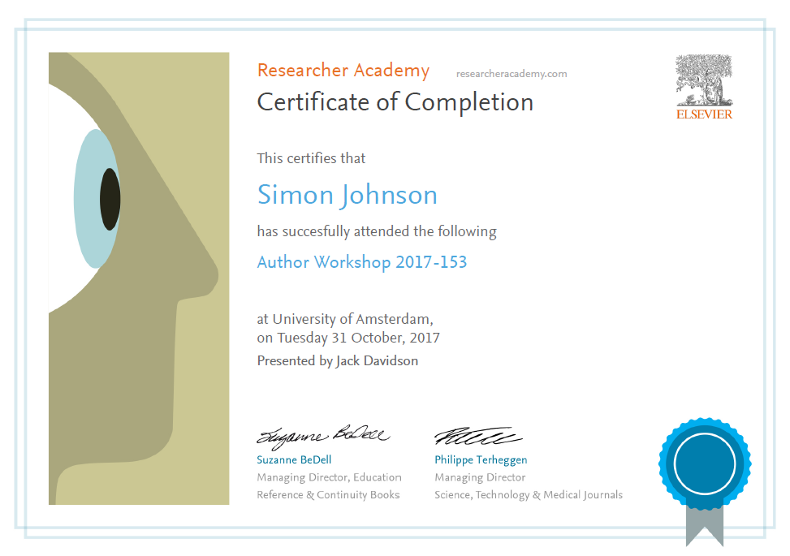

Thank you.
Ask your questions on:
Researcher Academy Mendeley group
Follow us on Twitter

