Slide 1
Confidential comments to editors and decision recommendation
Prof. dr. Bert Blocken
September 2019

Slide 2
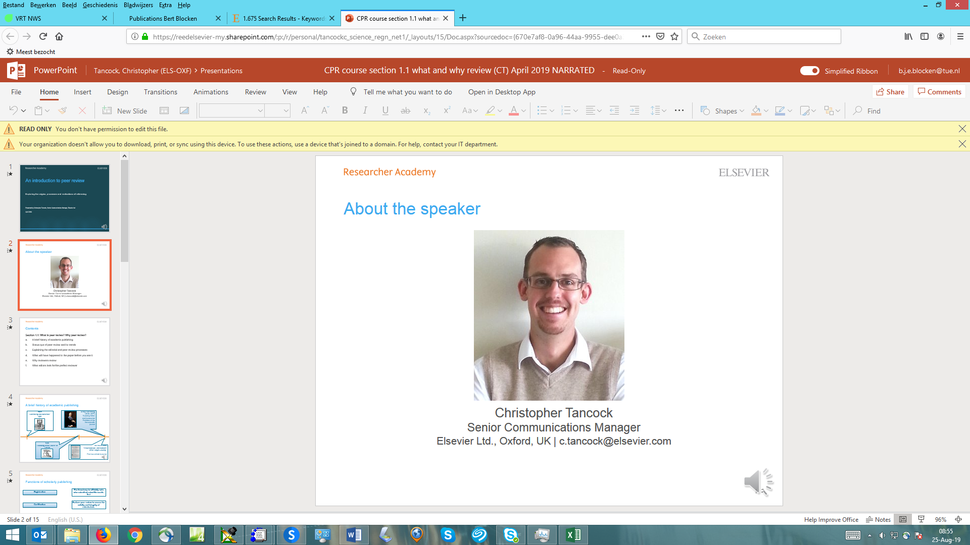

Prof. dr. Bert Blocken
Eindhoven University of Technology, the Netherlands
KU Leuven, Belgium

Slide 3
Contents
Section 3.2: Confidential comments to the editors
General impression
Novelty/importance/significance
Language and grammar
  Don’ts
  Language editing service(s) e.g. Elsevier Webshop
Concerns

Slide 4
General impression
Structure/length/readability
Is the manuscript properly structured?
Is the length appropriate?
Are the figures useful and readable?
Is the paper unambiguous and comprehensible, even if the English is not perfect?

Slide 5
General impression
Relevance/novelty
Is the work relevant?
If the work novel? (in an original article)
Has previously performed relevant work been cited and discussed?
Methodology/conclusions
Is the methodology appropriate and properly described?
Can the work by reproduced by others yielding the same outcomes?
Are the conclusions supported by the results?

Slide 6
General impression
Quality of figures

Slide 7
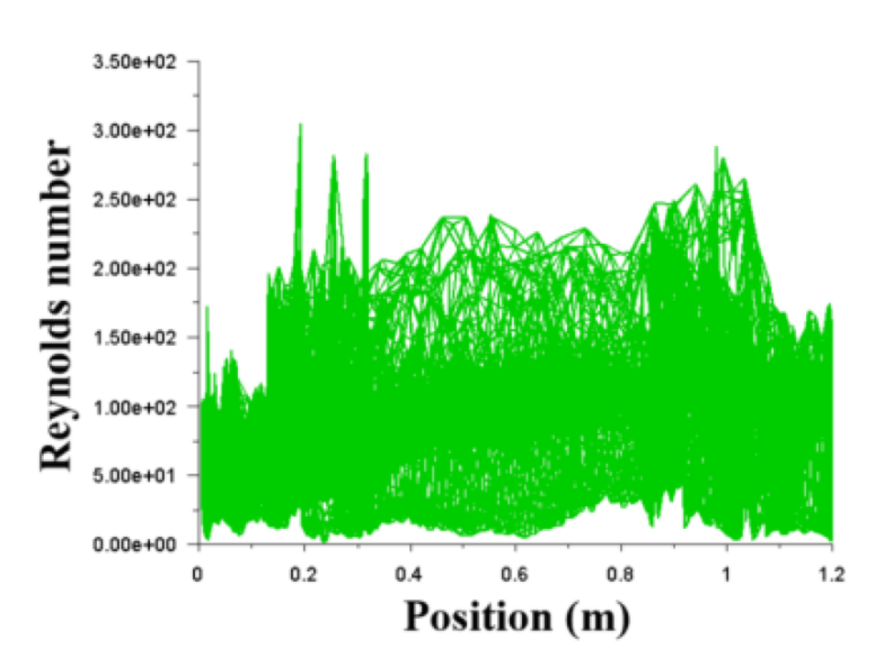
General impression
Quality of figures

Slide 8
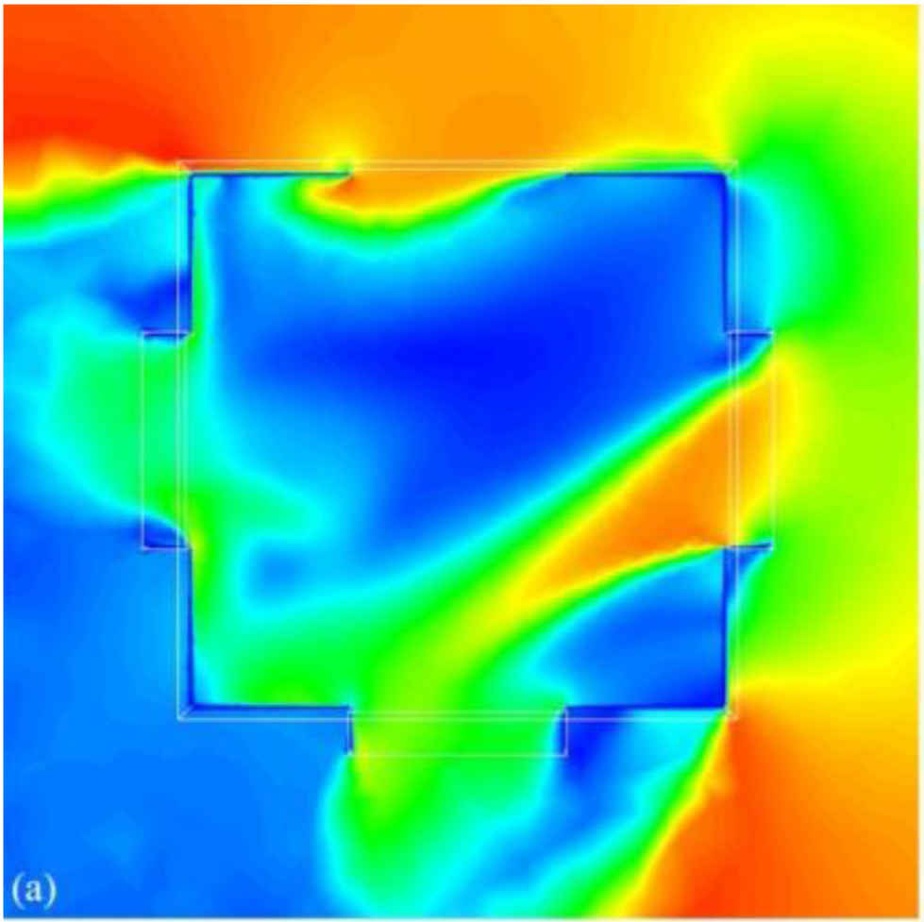
General impression
Quality of figures

Slide 9
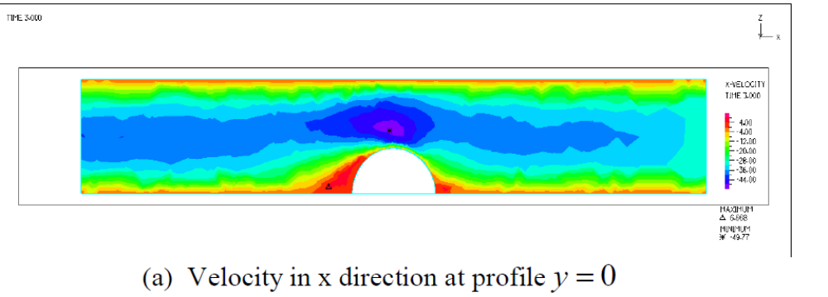
General impression
Quality of figures

Slide 10
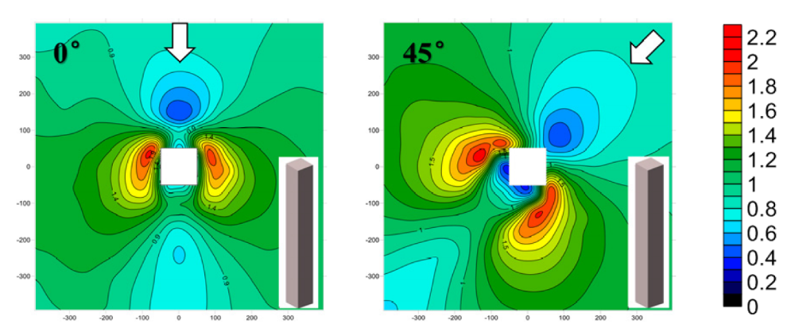
General impression
Quality of figures

Slide 11

General impression
Quality of figures

Slide 12
Novelty/importance/significance
A publication should add knowledge to the field. This evidently holds for original research articles, but also for review articles.
Novelty:
  should be highlighted in the article
  should be indicated by proper citation of previous work in the field of the article, including both old and recent references
Importance and significance should extend beyond minor issues or a particular application with limited or no general conclusions (e.g. particular building, only few measurement points, …) (no “parochial” research)

Slide 13

Novelty/importance/significance
Photo: Marcin Konsek / Wikimedia Commons / CC BY-SA 4.0

Slide 14
Language and grammar
Don’ts
If the language and grammar are such that the article is difficult or impossible to understand, do not proceed with the review.
If the manuscript can be understood but has many English language and grammar issues, do not try to fix these. Instead, suggest to the editor that the authors need to have the manuscript edited.
Do not spend time polishing grammar or spelling. However, do mention grammatical errors that affect proper understanding.

Slide 15
Language and grammar
Examples
Text that is difficult or impossible to understand
“The many studies investigated flow control have also been performed on the flow control using the moving surface mechanism.”
English language and grammar issues that do not impede understanding
“However, the specific relationship between urban wind environment components and pollutant concentration is still lack of in-depth research.”

Slide 16
Language and grammar
Language editing service(s) e.g. Elsevier Webshop
You can indicate to the editor that language editing needs to be performed, based on which he or she can impose this as a mandatory comment on the authors.

Slide 17
Concerns
Concerns not covered by the previous items can be important and should be mentioned to the editor. A major concern is identified or suspected plagiarism.

Slide 18
Concerns
Identified plagiarism: aware of very similar paper(s)
If too similar: New manuscript is not original. Inform the editor of the similar paper(s). Your recommendation should be “reject” (= a favor to the authors)
If not too similar: Dissimilarity should be highlighted. Inform the editor of the similar paper(s) and recommend how work can be differentiated (= a favor to the authors)

Slide 19
Concerns
Suspected plagiarism: suspect existence of very similar paper(s)
Inform editor on items in the manuscript that you suspect are being (self)plagiarized (= a favor to the authors)

Slide 20
Contents
Section 3.3: Decision recommendation
Accept/reject/minor/major
The editor’s decision is final

Slide 21
Accept/reject/minor/major
Accept
Very rare in first review round
Provide arguments for your recommendation that match your recommendation
Still, mention items that could be improved (if any)

Slide 22
Accept/reject/minor/major
Accept
Very rare in first review round
Provide arguments for your recommendation that match your recommendation
Still, mention items that could be improved (if any)
Reject
Could be done based on major flaws identified in “skim-read” or by identified (major) flaws based on thorough read.
Provide arguments for your recommendation that match your recommendation

Slide 23
Accept/reject/minor/major
Minor revision
Difference minor/major revision is not always very clear
Minor could be the recommendation if you would not need to see the revised manuscript again for a re-review
Provide arguments for your recommendation that match your recommendation
Suggest how authors can address your comments
You can distinguish between mandatory and non-mandatory comments
Number your comments and refer to page and line numbers
Remember that authors will not see the “confidential comments to editor”

Slide 24
Accept/reject/minor/major
Major revision
Major could be the recommendation if you would need to see the revised manuscript again for a re-review
Provide arguments for your recommendation that match your recommendation
Suggest how authors can address your comments
You can distinguish between mandatory and non-mandatory comments
Number your comments and refer to page and line numbers
Remember that authors will not see the “confidential comments to editor”

Slide 25
The editor’s decision is final
Based on reviews received and personal evaluation
Even though this decision might not be in line with your recommendation – therefore do not mention your recommendation (accept/reject/minor/major) in your comments to the authors.
If conflicting recommendations are received, the editor will generally give more weight to the reviews that are best outlined and argumented.
Usually the editor will notify you about his/her decision.

Slide 26

Thank you
Ask your questions on:
Researcher Academy Mendeley group
Follow us on Twitter

